Slide 1
Accredited Buyer’s Representative (ABR®)
Official Designation Course Version 5.2

Slide 2


Your Handout contains everything that appears on this slide deck and more! Things may appear differently for visual representation, but all content is in your Handout. Follow along …

Slide 3

Introduction

Slide 4

Course Goals
Understand and demonstrate your value to today’s buyer
Acquire the skills and resources to succeed as a buyer’s representative in a dynamic real estate market
Help buyers find the right property at the right terms and price in both buyer’s and seller’s markets
Assist in writing and negotiating their successful offer
5

Slide 5

What You Will Learn
Module 1: Value and Role of Buyer Representation
Module 5: Offers and Negotiations
Module 2: Buyer Counseling Session
Module 6: From Contract to Closing
Module 3: Buyer Representation Agreement
Module 7: Putting It All Together
Module 4: Search-Showing-Selecting Process
Resources and Exercises
6

Slide 6

Knowledge Base
This is not a basic class – it assumes you have a working knowledge of:
REALTOR® Code of Ethics
Fair Housing
Agency in your State
7

Slide 7
Become an ABR® Designee
Successful completion of the 2-day ABR® designation course
Successful completion of one of the ABR® elective courses,
May be taken prior to completing the 2-day course
Five (5) completed transactions
Solely as a buyer's representative (no dual agency)
Transactions done prior to taking course count, or
Three (3) years after course
Maintain active and good membership status with the Center for REALTOR® Development and the National Association of REALTORS®
8
Notes:
Course Notes:
Membership requirements for International Members differ slightly.
All requirements must be completed within three years of passing the Accredited Buyer's Representative (ABR®) designation course. Only REALTORS® who meet all these requirements and have been officially awarded the ABR® designation are permitted to call themselves an ABR® and use the ABR® logo.
Course enrollment includes a free, one-year membership. Annual dues are $110 each year thereafter.
Students can find complete information on requirements at abr.realtor or by calling 1-800-648-6224.

Slide 8
ABR® Member Benefits
Private Facebook Networking Group
Networking/Referrals with 35,000 ABR® designees
Customizable Marketing Materials
Tools for Working with Buyers
Publications and Other Resources
9

Slide 9
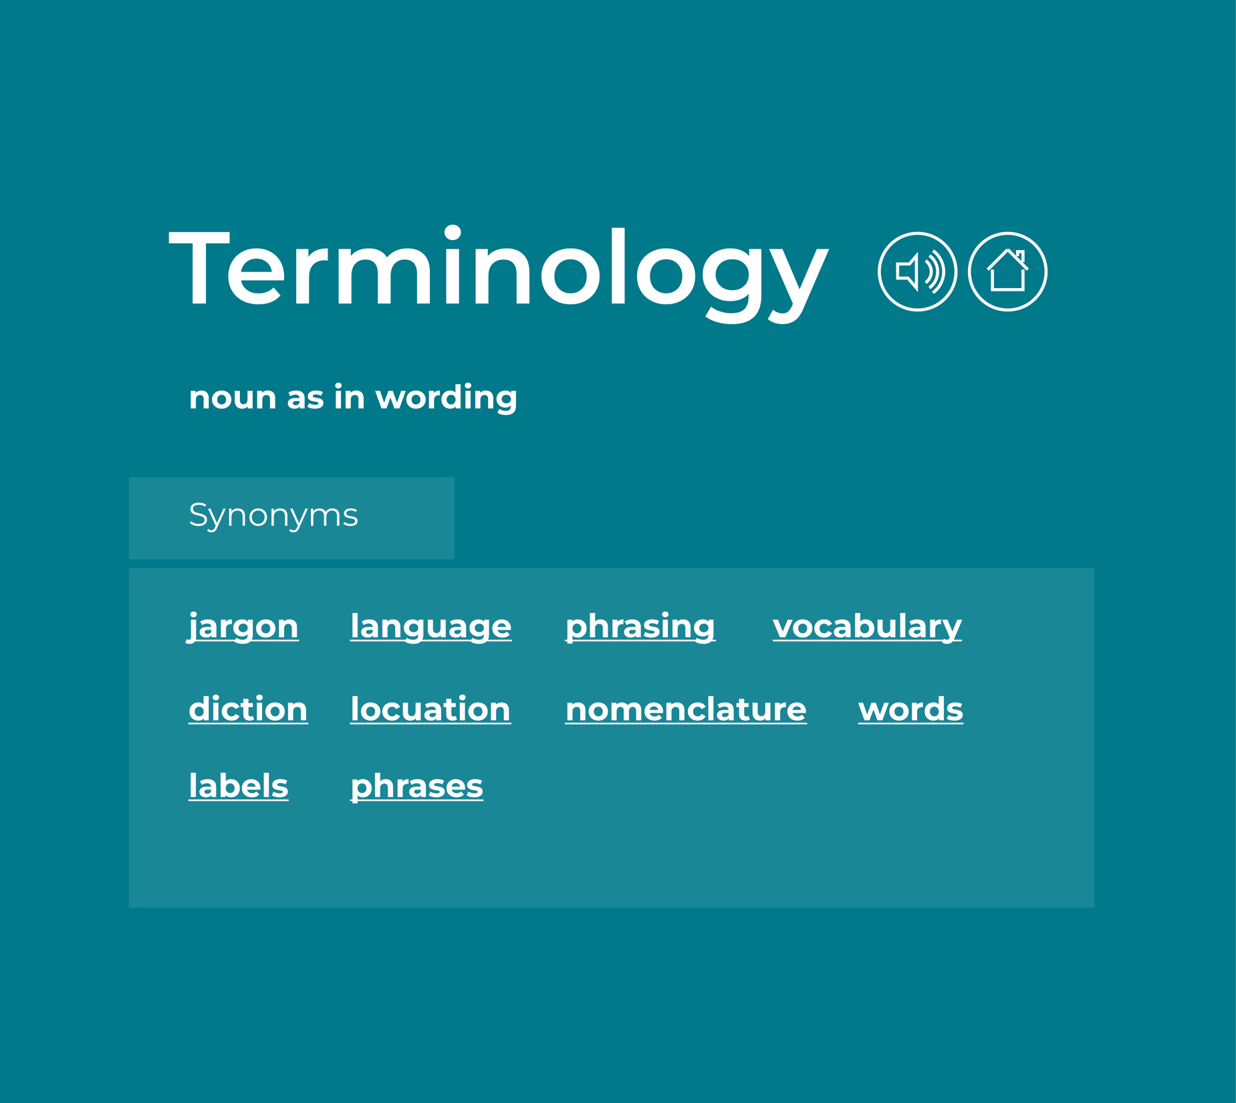
“Salesperson” “Broker” “Managing Broker” “Broker in Charge” “Designated Broker” “Sponsoring Broker”
These terms vary from state-to-state
We have tried to use commonly used terms and define unfamiliar terms whenever possible
There is a glossary of terms in the Resources section
10
Notes:
This is especially important if you have a class with students from different states. Clarify and move on.

Slide 10

Protect the REALTOR® Trademark
REALTOR® is a federally registered collective membership mark.
Identifies a real estate professional as a member of the NATIONAL ASSOCIATION OF REALTORS® who subscribes to its strict Code of Ethics
REALTOR® may only be used to convey this official meaning
A non-member is never permitted to use REALTOR® or REALTOR-ASSOCIATE® adjacent to their name on a business card or anywhere else
11
Notes:
Course Notes:
See the NAR Brand Style Guide Manual at https://www.nar.realtor/narbrand for complete details.

Slide 11

Module 1: Value and Role of Buyer Representation

Slide 12
Module 1 Learning Objects
Recognize how a buyer–agent relationship is legally formed
Understand your duties and responsibilities as a buyer’s representative
13

Slide 13

You Are the Buyer’s Advocate
You are on the buyer’s side
Find client the right home at the best price and terms
Serve as a trusted guide throughout the process
Protect client’s interests
Safeguard confidential information
14

Slide 14

What Do Buyers Value?
You are the expert they are seeking
Services
Information
Guidance
15

Slide 15
What Buyers Want Most from Agents
Source: 2021 National Association of REALTORS® Home Buyer and Seller Generational Trends, p 69.
16
Notes:
https://www.nar.realtor/sites/default/files/documents/2021-home-buyers-and-sellers-generational-trends-03-16-2021.pdf

Slide 16


Most Important Factors in Choosing an Agent
You both develop and control these factors
Honesty
Experience
Reputation
17

Slide 17
Use of Internet to Search for Homes (Percentage of Respondents)
Source: 2021 National Association of REALTORS® Home Buyer and Seller Generational Trends, p 57.
18
Notes:
Simply to show the use of the Internet by buyers – use as you would like but it does work as a lead-in to the next topic.

Slide 18
Information Sources Used When They Get Serious, It Changes
 | Age of Home Buyer
 | All Buyers | 24 to 32 | 33 to 42 | 43 to 57 | 58 to 67 | 68 to 76 | 77 to 97
Real estate agent | 86% | 87% | 83% | 84% | 87% | 88% | 86%
Mobile or tablet search device | 73 | 84 | 86 | 77 | 70 | 49 | 54
Online video site | 40 | 26 | 30 | 45 | 51 | 40 | 41
Yard sign | 39 | 41 | 42 | 36 | 35 | 39 | 39
Open house | 28 | 31 | 30 | 29 | 25 | 27 | 36
Print newspaper advertisement | 12 | 9 | 11 | 12 | 8 | 21 | 14
Home builder | 9 | 8 | 8 | 9 | 8 | 11 | 17
Home book or magazine | 7 | 4 | 7 | 7 | 8 | 7 | 8
Billboard | 2 | 2 | 3 | 2 | 1 | 3 | 2
Television | 2 | 1 | 3 | 2 | 1 | 1 | 6
Relocation Company | 2 | 1 | 2 | 2 | 1| | * | 3
Source: 2023 National Association of REALTORS® Home Buyer and Seller Generational Trends, p 50.
19
Notes:
2023 National Association of REALTORS® Home Buyer and Seller Generational Trends, p 50.

Slide 19
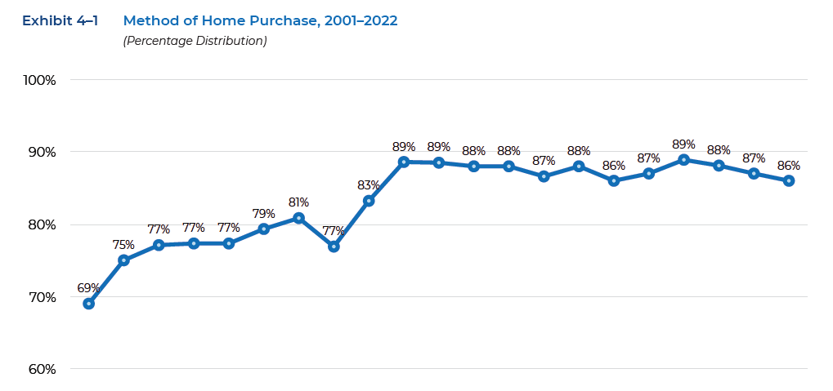
Method of Home Purchase
Most Use An Agent — In 2022, 86% of buyers used an agent
Source: 2023 National Association of REALTORS® Home Buyer and Seller Generational Trends, p 68.
20
Notes:
This one just reinforces that no matter that they start on the Internet – they are still using an agent to buy.

Slide 20

How Do Buyers Find Agents?
Referred by or was a friend, neighbor, relative – 38%
Referred by another real estate professional – 6%
Used agent’s services previously – 12%
Met agent at open house – 3%
Website – 9%
Inquired about specific property – 10%
Source: 2023 National Association of REALTORS® Home Buyer and Seller Generational Trends, p 68.
21

Slide 21
A Few More Stats
52%
45%
Buyers Ages 22-30
Buyers Ages 31-40
52% found agents through personal referrals
45% found agents through personal referrals
Source: 2021 National Association of REALTORS® Home Buyer and Seller Generational Trends, p 71.
22

Slide 22


What Does This Mean for You?
You are your business
Every personal interaction and relationship matters
Clients
Other agents
Community residents
Local businesses
23

Slide 23

How the Buyer–Agent Relationship Is Formed
Strong relationships are built on strong first impressions
Build trust throughout the process for a productive working relationship
Knowing the legal aspects of the relationship is critical
24

Slide 24
Common Mistakes in Agency Discussions
Acting: Acting like a buyer’s representative without clarifying the relationship
Avoiding: Avoiding discussion of contract to avoid “pressuring” the buyer
Relying: Relying on state’s default agency position
Assuming: Assuming buyers know you are “on their side”
Delaying: Delaying signing buyer representation agreement until buyer is ready to make offer
25

Slide 25
What Determines Your Relationship?
Your relationship with a buyer-client is determined by:
State Law
Office Policy
Actions
Services buyers value most can be offered only in a buyer-agent relationship
26

Slide 26

Respect Exclusive Agreements
Just a reminder – we must determine if they are in an exclusive agreement with another brokerage
We’ll cover it thoroughly in Module 2
27

Slide 27
Agency Disclosure and Confidential Information
Must take place before any substantive discussions
Many states require written explanation of all legal forms of brokerage — even if not offered by the brokerage
Caution prospects against sharing confidential information
In your state:
Designated Agency
Notice of No Agency
Dual Agency
28

Slide 28
Types of Representation Agreements
Express Agreements can be…
Written Agreements
Buyer Rep
Listing Agreement
Right to Lease
Property Management
Oral
Action
Implied Agreements can be created by…
Actions
Statements
Conduct
29

Slide 29

Implied Agreements
It can happen without agent’s consent
Conduct can create agency even if there is a signed acknowledgement saying you are NOT their agent
Often state specific
Often happens when seller’s agent works with buyer customer without proper disclosure
30

Slide 30

State of Agency Disclosure
How is agency disclosure done in your state?
Is that enough?
31
Notes:
Simply verify they are all on the same page with the state’s requirements and have a brief discussion of whether more disclosure should be done than what the minimum requirement is.

Slide 31

Are You In Sync With Your Brokerage?
Types of agency relationships
Statement of agency policy
Rationale for the company’s policy
Required disclosures
Disclosure forms
Exclusive buyer rep agreements
Number of buyer- clients at one time
Dual agency option
Designated agency option
Implementation of dual or designated
Interaction with clients and customers
Agent behavior in each type
Client confidentiality
Contemporaneous offers
32
Notes:
If you are doing the course for a specific brokerage, this is a great place to be sure all the agents area aware of the company requirements. Caution: don’t spend too much time on this!

Slide 32
What Are Your Duties and Responsibilities?
Duties to Clients (OLDCAR)
Obedience
Loyalty
Disclosure
Confidentiality
Accounting
Reasonable care/diligence
Responsibilities to Customers (HARD)
Honesty
Accounting
Reasonable skill/care
Disclosures
33

Slide 33

Obedience and Loyalty
Follow client’s lawful instructions
Put client's interests ahead of all others
Treat all parties honestly
Code of Ethics Article 1:
When representing a buyer, seller, landlord, tenant, or other client as an agent, REALTORS® pledge themselves to protect and promote the interests of their client. This obligation to the client is primary, but it does not relieve REALTORS® of their obligation to treat all parties honestly. When serving a buyer, seller, landlord, tenant or other party in a non-agency capacity, REALTORS® remain obligated to treat all parties honestly. (Amended 1/01)
34

Slide 34
Disclosure
Affirmatively disclose all information that could affect the buyer’s decision to purchase or the price they may be willing to pay
Code of Ethics Article 2:
REALTORS® shall avoid exaggeration, misrepresentation, or concealment of pertinent facts relating to the property or the transaction. REALTORS® shall not, however, be obligated to discover latent defects in the property, to advise on matters outside the scope of their real estate license, or to disclose facts which are confidential under the scope of agency or non-agency relationships as defined by state law. (Amended 1/00)
35

Slide 35
Confidentiality
Information learned about clients or told to you by clients stays confidential after the termination of the agency relationship
Code of Ethics Article 1, Standard of Practice 1-9:
The obligation of REALTORS® to preserve confidential information (as defined by state law) provided by their clients in the course of any agency relationship or non-agency relationship recognized by law continues after termination of agency relationships or any non-agency relationships recognized by law. (Adopted 1/93, Amended 1/01)
36

Slide 36
Confidential Information
Stays confidential after transaction or termination
Some states require confidentiality to customers
In some states, confidentiality obligations end with agency relationship, but remember the COE has a higher standard (SOP 1-9)
Ceases to be confidential when it becomes public, or client releases the info
Be cautious on giving feedback – can violate confidential information rules
No requirement you give feedback
Get client’s permission
Negotiating could start here
37

Slide 37
Accounting
Safeguard money and property being held on behalf of the client.
Code of Ethics Article 8:
REALTORS® shall keep in a special account in an appropriate financial institution, separated from their own funds, monies coming into their possession in trust for other persons, such as escrows, trust funds, clients’ monies, and other like items.
38

Slide 38
Reasonable Care and Diligence
Protect clients from foreseeable risks or harm
Article 13:
REALTORS® shall not engage in activities that constitute the unauthorized practice of law and shall recommend that legal counsel be obtained when the transaction requires it.
39

Slide 39
Reasonable Care and Diligence
Necessary clauses and contingencies needed to protect the buyer
Prepare a CMA for buyer clients
Provide home warranty information
Provide info about issues affecting value or resale
Advise on additional charges and costs
Obtain all required disclosures from seller
Advise buyer to check on important issues
40

Slide 40
Reasonable Care and Diligence
Recommend inspections
Provide lists of other professionals
Inform client of possible negative influences
Let client know where info came from
Not always verified
Came from seller or listing agent
May need independent verification
41

Slide 41

Responsibilities to Customers (HARD)
Honesty
Accounting
Reasonable Skill
Disclosures
It can be HARD to work with customers – they want to be treated like clients
42
Notes:
Course Notes:
Continue the discussion of the Standards of Practice and Code of Ethics (Honesty/Accounting/Reasonable Skill)
Code of Ethics Article 1: When representing a buyer, seller, landlord, tenant, or other client as an agent, REALTORS® pledge themselves to protect and promote the interests of their client. This obligation to the client is primary, but it does not relieve REALTORS® of their obligation to treat all parties honestly. When serving a buyer, seller, landlord, tenant or other party in a non-agency capacity, REALTORS® remain obligated to treat all parties honestly. (Amended 1/01)
Code of Ethics Article 8: REALTORS® shall keep in a special account in an appropriate financial institution, separated from their own funds, monies coming into their possession in trust for other persons, such as escrows, trust funds, clients’ monies, and other like items.
Code of Ethics Article 11: The services which REALTORS® provide to their clients and customers shall conform to the standards of practice and competence which are reasonably expected in the specific real estate disciplines in which they engage; specifically, residential real estate brokerage, real property management, commercial and industrial real estate brokerage, land brokerage, real estate appraisal, real estate counseling, real estate syndication, real estate auction, and international real estate.

Slide 42

Code of Ethics
Honesty – Article 1
Promote clients' interests – but
Treat all parties honestly
Accounting – Article 8
Keep all funds in special account
Reasonable Skill – Article 11
Must have geographic competence, familiar with type of property and have access to appropriate information
Disclosure of Material Facts – Article 2
43

Slide 43
Code of Ethics
Code of Ethics Article 2:
REALTORS® shall avoid exaggeration, misrepresentation, or concealment of pertinent facts relating to the property or the transaction. REALTORS® shall not, however, be obligated to discover latent defects in the property, to advise on matters outside the scope of their real estate license, or to disclose facts which are confidential under the scope of agency or non-agency relationships as defined by state law. (Amended 1/00)
44

Slide 44
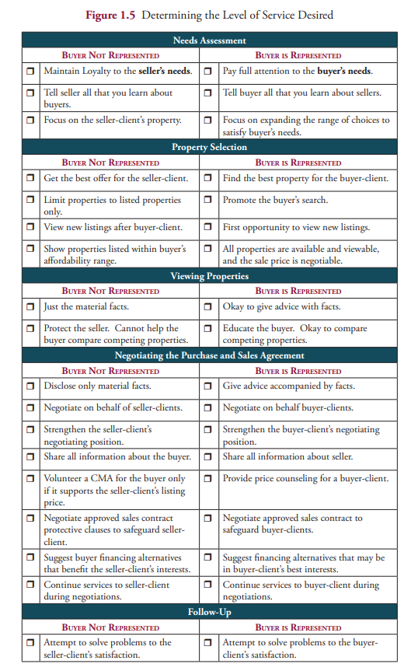
Level of Service Checklist
Spells out difference between client and customer
Determines level of service desired
Illustrates your value
45

Slide 45

Key Point Review —Module 1
The relationship between client and agent is legally binding and carries specific duties
Representation agreements can be express or implied; their specific terms vary by state
REALTORS® must know and abide by the Code of Ethics and Standards of Practice
46

Slide 46

A Day in the Life of … A Buyer’s Rep
At the end of every Module, you will find a recap scenario for you to do on your own time – an opportunity to reinforce what we covered
47

Slide 47

Module 2: Buyer Counseling Session

Slide 48
Module 2 Learning Objectives
Conduct a successful counseling session that educates the buyer, builds trust, and leads to a signed buyer representation agreement
Articulate your value proposition to the buyers – what you do – how you do it and why it is important to them
Institute a personal safety plan when working with buyer clients
49

Slide 49

Goals of Counseling Session
Convert contact to successful transaction
Achieving positive outcomes requires
People skills
Knowledge – Representation skills
Your opportunity to show how what you provide meets their needs
Make the most of this opportunity
50

Slide 50

First Meetings
Sets the tone for the buyer–agent relationship
Opportunity to share your value and services
Present your unique value proposition
Start learning about the buyer
Their situation
Length of search
Home-buying goals
51

Slide 51
Code of Ethics
Standard of Practice 16-9
REALTORS®, prior to entering into a representation agreement, have an affirmative obligation to make reasonable efforts to determine whether the prospect is subject to a current, valid exclusive agreement to provide the same type of real estate service. (Amended 1/04)
52

Slide 52
Utilizing Technology

Slide 53

Utilizing Technology
Your first meeting with the buyer does not always have to be face-to-face
Meeting them on Zoom or other virtual platform is convenient for both you and your buyers
You can build rapport and find out important information prior to the first showing appointment
54

Slide 54
Advantages
Saves time
Less pressure on them
Sets the tone for professional working relationship
55

Slide 55
Set Up On-Line Session
Set up Zoom account
Familiarize yourself with features
Set up the meeting – invite them
Prepare agenda and materials and practice sharing your screen
You can record the conversation and send it to them – get permission to record – some states require it
This is the beginning of your counseling session – it continues throughout your time together
56

Slide 56
Loyalty is seldom created by accident
The counseling session allows you to find out what is important to them
It gives you the ability to educate them about what they need to know to be an educated, informed buyer
Your opportunity to show how buyer representation provides the services the buyers value
Educate buyers about why they should use an agent and the services they provide as part of the transaction
57

Slide 57

Why do a counseling session?
Helps you understand buyers’ goals, motivations, budget, timeline
Allows you time to explain your services, duties
Opportunity to introduce buyer rep agreement
Builds trust, rapport and loyalty
Increases chances of successful transaction
58

Slide 58
Who Are Your Buyers?
Sphere of Influence
They know you
They like you
Opportunity to learn about your services!
Important you approach them professionally – don’t take shortcuts
59

Slide 59

First Contact New Clients
Don’t know you
Need to build rapport
More important to communicate your unique selling proposition
60

Slide 60


Buyer Representative Safety
Proactively devise – and follow – a personal safety plan
Avoid tricky or unsafe situations by reviewing the REALTOR® Safety Tips from NAR
61

Slide 61

Using Active Listening
One of the most effective tools you can have in your toolbox
If you ask the right questions – pay attention to the answers you can uncover ‘red flags’ if the caller has ulterior motives
For more information on this relatively new approach to REALTOR® Safety, there is a link in your manuals to the published materials
62

Slide 62
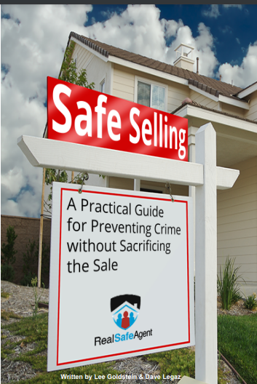
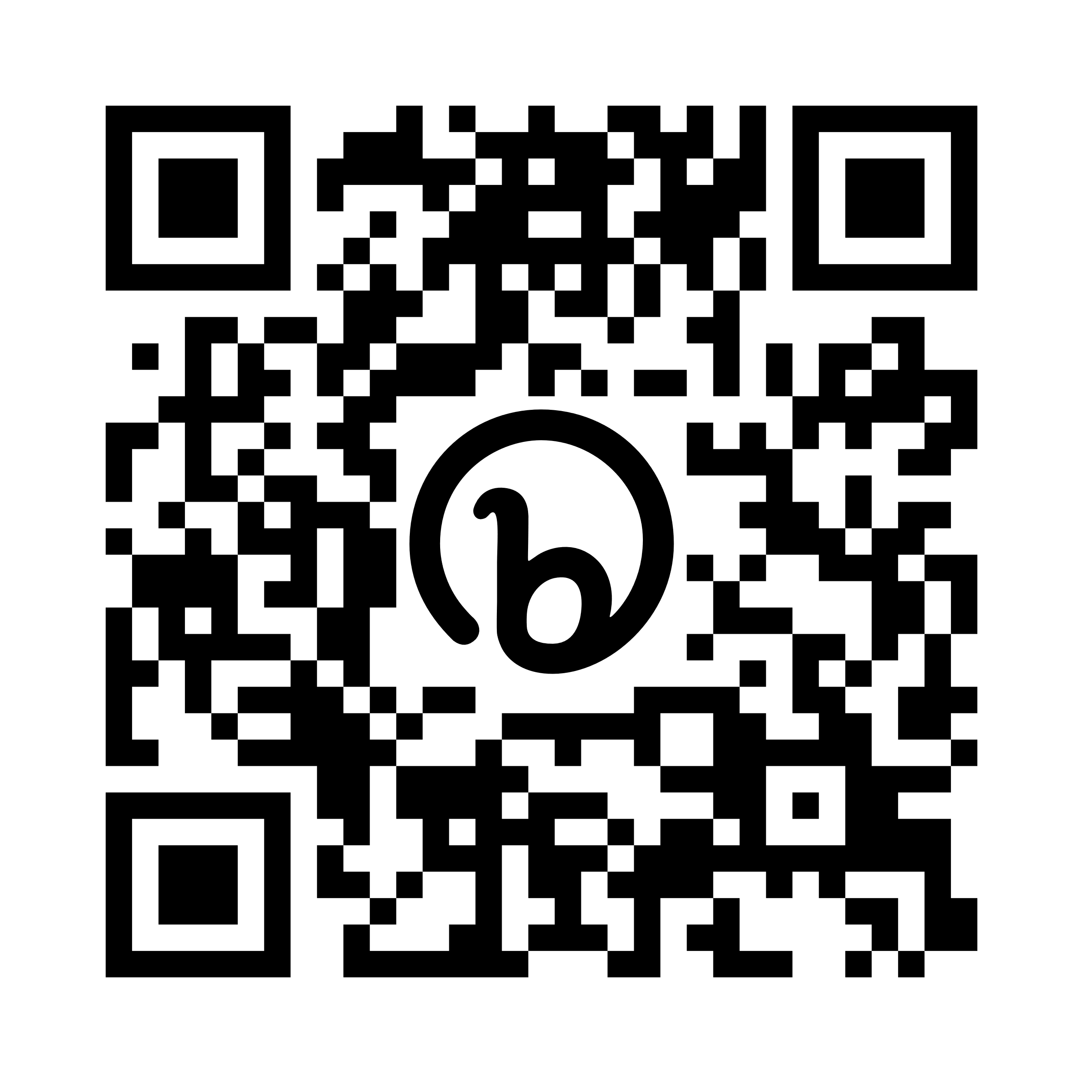
Safe Selling A Practical Guide to Preventing Crime Without Sacrificing the Sale
https://www.nysar.com/wp-content/uploads/2021/01/David_Legaz_Safe_Selling_Book.pdf
63
Notes:
Reference slide for information on handling incoming calls – pages 34 – 36 in Manual. If manuals are printed the link – obviously – won’t be ‘clickable’ so we included this slide – use it as you wish – delete or show.

Slide 63

The Initial Call – Active Listening
Prospect: I saw this house online and I’d like to see it
Agent: OK, what about the house appealed to you?
Prospect: I just liked it
If someone liked a house – there should be at least one specific thing they mention.
64

Slide 64
The Initial Call – Active Listening
Agent: OK, I’d like to make sure I can answer any questions you may have during the showing. Is there anything about the house or neighborhood that’s important for you to know?
Prospect: Not really
Inability to specifically answer reasonable questions should be a red flag.
65

Slide 65
The Initial Call – Active Listening
Agent: I know you found the house online. How did you locate me?
Prospect: Online, the same site as the house
Agent: Great, it’s nice to know that I’m getting some attention, sometimes it’s difficult to evaluate what sites are getting my name out there. What site did you find me on?
Prospect: BigDataRealEstate.com
If that’s not a site the agent uses – another red flag.
66

Slide 66
The Initial Call – Active Listening
Agent: I understand that BigDataRealEstate.com also recommends mortgage providers, have you already been pre-qualified?
Prospect: Yes
Agent: Great, who have you been working with? (You may even tell them it’s because as a matter of policy you need to have the pre-approval paperwork)
Prospect: I can’t remember
If they don’t – obvious red flag.
67

Slide 67

Each question builds on the answer
Practice so you can do this naturally
The vast majority of prospects are legit
You don’t want to scare them off!
68

Slide 68
Prospect: I found this house online and I’d like to see it.
Agent: OK, what about the house appealed to you?
Prospect: I’ve seen other houses in the neighborhood and wasn’t thrilled, but I liked the looks of this house.
Agent: Sounds like you’ve been putting some time into this. Have you seen those houses with other agents?
Adjust questions based on prospects responses – this is a much more legit response than some of the others.
These are short versions of what would be longer real conversations – work on them and others to get more info before you ever meet anyone – anywhere!
69

Slide 69
Using Neighborhood Info
Agent (spoken to prospect on the phone): I really like that property. The house has a great feel to it, lots of windows, great visibility. I’ve also met some of the neighbors and it seems like a close knit, friendly neighborhood.
Throws out the idea that there are people watching the house – could drop in – not as isolated as caller may think.
Don’t lie – as listing agent you should have introduced yourself to neighbors anyway.
70

Slide 70
The Training Play
During the call you mention that the office has a new agent you are training and he will be joining you.
You may even add: “You’ll really like Eric. He’s a great guy, he used to be a pro football player and he’s always telling stories”
Prospect’s reaction may give you info you need.
You also may never hear from them again!
71

Slide 71
First Meeting
Meet in your office or public place
Require an ID
Introduce to a colleague
Get them preapproved prior to showing
72
Notes:
Course Notes:
These next four slides do not exactly follow the manual – they are tips on safety – feel free to modify them for your marketplace or what you want to emphasize

Slide 72
Showing Property
Walk behind prospect
Do not go into confined spaces
Keep your cell phone in hand
Use a buddy system
Schedule a check-in call
Leave if you feel uncomfortable
73

Slide 73
Open Houses
Check ID
End of advertised open most dangerous
Use buddy system
Do not go in basement or attic
Plan escape route and – again – leave if you feel threatened
74

Slide 74
Other Tips
Use background checking apps – FOREWARN
SentriLock has a safety system
Don’t park your car in driveway – park at curb if possible
Check your company protocols for more safety precautions
75

Slide 75

The Counseling Session
Introduction of you and your credentials
Review agenda and objectives
Discovery of buyers needs and wants
Discussion of buyers' financial situation and pre-approval status
Presentation of your services
Explanation of homebuying process
Introduction of buyer rep agreement
Plan of action for next steps
76

Slide 76
You will need to have responses to these typical statements:
“I don’t need to meet with you first. I already know the house I want to see, just meet me there.”
“Why do I need to talk to a lender? I know what I can afford.”
“I don’t need to talk to a lender – I am a cash buyer.”
77

Slide 77
What Do You Say?
Spend time in advance developing responses so that you are prepared to respond to consumers questions and requests, including ‘meet me at the house’!
78

Slide 78

Your Unique Value Proposition
Education
Specialized training
Expertise
Market knowledge
Skills
Experience
What you’ve done
What you’ve learned
Essence
What you stand for
79

Slide 79
All licensees are not alike
Not all licensees give buyers the same level of service
You need to differentiate yourself from other agents by articulating your services
You need a unique value proposition that represents your personal style
We cannot get loyalty from the buyers without showing our loyalty to them and what we do to help them find the right home – at the right price and terms – and get to the closing table!
80

Slide 80
Know Your Unique Value Proposition
Tailored to your clients and your market
Gives you competitive advantage
Your market distinction – expressed as services you offer to buyers
Center for REALTOR® Development ©2024
81

Slide 81
Fine Tuning Your Value Proposition
As we go throughout the course – this is the page you can come back to – to fine-tune your value proposition.
When something comes up that you do – want to do – or know you should do – put it here – come back to it and create your personalized list.
82

Slide 82

Learn About the Buyer
Buyers get excited about features they want – and miss the features they need
May not know what they want
Why are they buying?
Need office space?
Room for children?
Want something smaller?
Be in tune with a buyer's stated needs and wants in their property search
83

Slide 83
Buyer Consultation Questions
How long have you been looking for a home?
How have you been doing that?
Have any agents shown you houses?
What was your relationship with them?
What did you sign with them?
Did you see anything you liked?
What kept you from buying it?
?
Center for REALTOR® Development ©2024
84

Slide 84
Buyer Qualifying Questions
Can you describe your ideal home?
If we can’t find everything – what would you compromise on?
Deal breakers?
Tell me a little bit about your lifestyle?
If money were no object – what have you always wanted?
Anything else I need to know?
?
85

Slide 85
The Home Buyer’s Checklist
Feature | Buyer’s Wants | Have To Have It | Would Like | Not Needed
Style of Home
Age of Home
Neighborhood
Bedrooms #
Bathrooms #
Kitchen
Living Spaces
Designated Office
Storage
Basement
Garage/Parking
Heating
Air Conditioning
Floor Plan/Room Sizes
Outdoor Space
Additional Amenities
86

Slide 86

Do prequalification step
Talk with buyer about working with a lender and getting pre-approved
Connect buyer with lenders
Articulate for the buyer the benefits of getting a pre-approval, including that it helps the buyer narrow down their search to a price range they can afford and can be used to demonstrate their seriousness to a potential seller
87

Slide 87
Provide agency disclosures
Ensure appropriate timing of disclosures
Discuss specific type of agency relationship
Provide state required disclosures
88

Slide 88
Establish Price Parameters
Preapproval is critical
You don’t want to be showing $500,000 properties to a buyer who can only go to $400,000
Saves time for you both
$
89

Slide 89
Ask The Lender
Talk with the lender – did they verify:
Buyers’ credit
Employment
Self-employed taxable income
What type of financing are they qualified for?
Or better yet – have your buyers use your preferred lender who you know does all this!
90

Slide 90
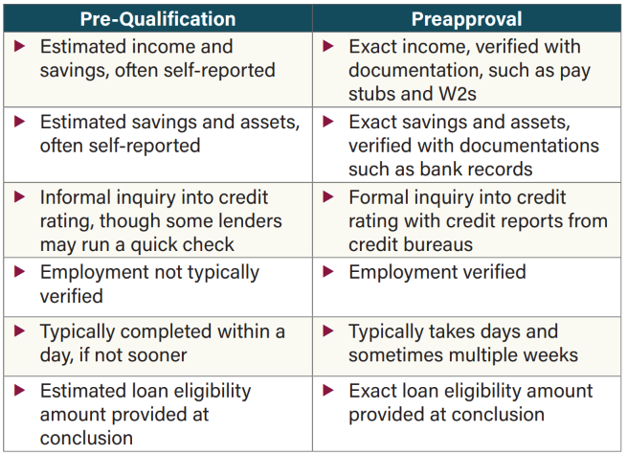

Official ABR® Elective Course
Center for REALTOR® Development ©2024
91

Slide 91
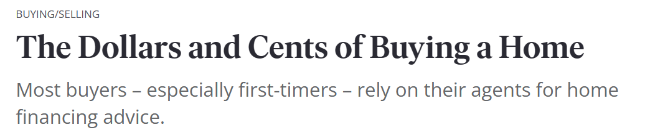
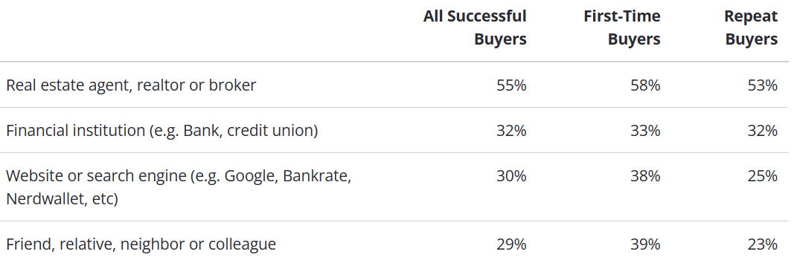
Zillow Survey was done in December 2022
Center for REALTOR® Development ©2024
92
Notes:
Reinforces the need for buyer reps to know something about financing.

Slide 92

You’re skilled at guiding clients through the home buying process. But do you ever receive questions about mortgage options that you don’t know how to answer?
The Home Finance Resource Certification Course is designed to provide you with foundational education to help you confidently explain key pieces of the loan origination process.
With the skills that you gain from this course, you will also be equipped to provide guidance on navigating mortgage applications and alternative financing options for all types of buyers.
93

Slide 93
Financing Savvy Remember: VA & FHA loans are assumable – could help both buyers and sellers
Typical lender does this
You can help your clients better if you:
Find the right program and know mortgage products
Know what local lenders have and state programs that may be available
Show them options
Explain TRID
Many buyers assume they need 20% down
Not all loan officers provide personalized service
This can be a big part of your value proposition
94

Slide 94
Obviously, purchasing a home is a complex process and my job is to help you navigate through all of it. As I mentioned, my job is to help you find the right property – at the right price – negotiate the best terms for you and get your transaction to the closing table.
Let’s look at an overview of the process and the expenses you will encounter and how I can help you accomplish your goals.
Use What-How-Why
Buyer Counseling Packet
Walk them through the purchase process
Proactively cover the typical questions
Use List of Possible Expenses
95

Slide 95
What makes you stand out? Why are you unique?

Slide 96
Features and Benefits
Feature
Element of what you do
Describes a service
Assumes client understands importance
Benefit
Describe service – but,
We need to tie it to how it improves client’s situation
97

Slide 97
Benefits and Features
Reword in terms client understands
Don’t show off your knowledge with terminology
Use ‘which means to you’ segue
Turn everything into an advantage
Tell a story of how the feature/service helped another client
98

Slide 98

Add the value – the why!
Not always clear to client why it’s important
People do business with you because they have needs
What you do must satisfy a need
And in real estate – they sometimes don’t even understand WHY they need it!
99

Slide 99

Educate Buyers on Your Role
To get commitment from the buyer – we must show them what we do
Many believe they have all the info they need to be an educated buyer – we know that’s not usually the case
Understanding what we do and how it benefits buyers is critical to attracting their business
100

Slide 100

Value Proposition
This is your value proposition – your promise of service that differentiates you from the others
Buyers will not choose you unless you give them reasons why you are the answer to their needs
101

Slide 101
How Do You Add Value?

Slide 102
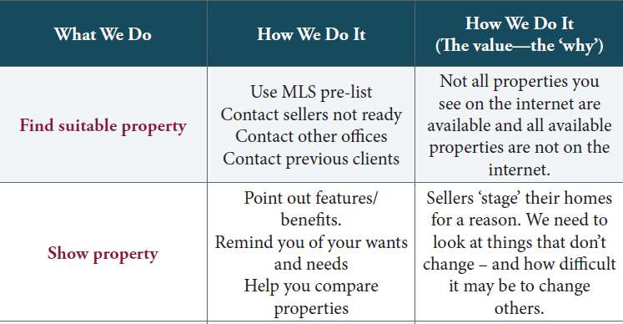
103

Slide 103
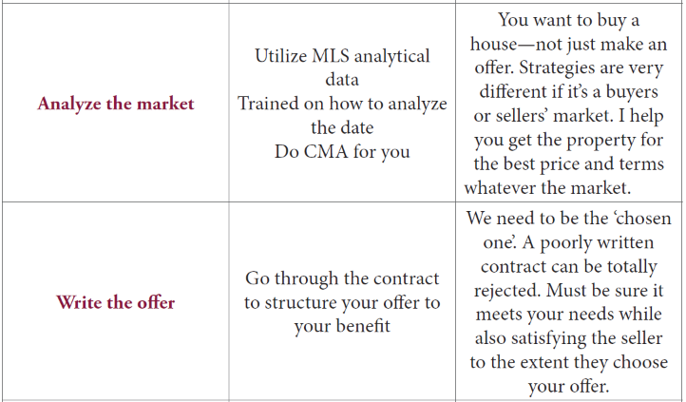
104

Slide 104
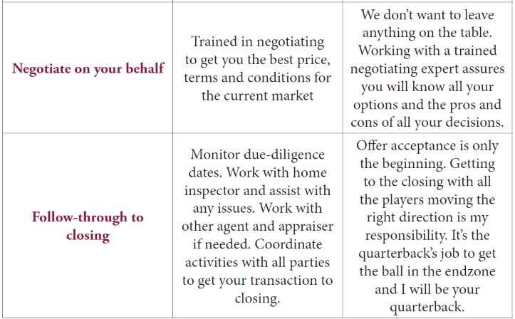
105

Slide 105
Buyer Counseling Packets
Welcome letter
Testimonials
Agency disclosures
Pledge of Performance
Mortgage process
List of service providers
Property disclosures
Due diligence dates
Transaction flow chart
Home Buyers’ Checklist
Home Buying Guidelines
Sample sales contract
How you assist with:
Open houses
FSBOs
For-sale signs
New construction
106

Slide 106

Contract
Assist consumer in understanding the information that needs to be completed in the contract.
Highlight relevant section:
Price, earnest money
Financing
Home inspection
Due diligence dates
Center for REALTOR® Development ©2024
107
Notes:
This is just to emphasize giving the buyer a copy of the contract – suggest not a blank but one filled in as an example with most important paragraphs emphasized

Slide 107
“These are the major steps in the purchase process – there are plenty more! It is my job to orchestrate the successful execution of each of these steps to assist you in getting the right home, at the right price and terms and get you to the closing table.”
Determine your wants and needs
Assist you in getting pre-approved for your mortgage
The search begins!
Re-analyze your wants and needs, if necessary
The search continues!
108

Slide 108
Proactively search for new listings as they come on the market
Assist you in determining your offer price – do a market analysis
Write an offer that has the highest odds of being accepted
Negotiate for the best price and terms
Coordinate the home inspection
Resolve any home inspection issues
Coordinate survey, termite, well & septic and other inspections
Resolve appraisal issues, if any
Coordinate all parties and handle issues to get to a successful closing
109

Slide 109
Buyers Questions
?
NAR Research showed these were the questions most sites tell buyers to ask
Be prepared – build them into your session
110

Slide 110
Use of Internet to Search for Homes (Percentage of Respondents)
Source: 2021 National Association of REALTORS® Home Buyer and Seller Generational Trends, p 57.
111
Notes:
Simply to show the use of the Internet by buyers – use as you would like but it does work as a lead-in to the next topic.

Slide 111
Be Prepared to Answer The Top Ten List
Can you tell me about your career in real estate?
How many homes have you sold in this area?
How familiar are you with this area and price range?
What is your strategy to help us find the right home?
How many other clients are you representing?
112

Slide 112
Be Prepared to Answer The Top Ten List
Can you provide references?
What separates you from your competition?
How much do you charge?
Can you tell me about your negotiation style and experience?
What is your approach to winning a bidding war?
113

Slide 113
The Complete Cost of Homeownership
Educating your buyer on big-picture costs of homeownership:
Helps buyers make informed decisions
Reinforces the value of buyer representation
Strengthens your relationship with your buyer-client
Wins buyer-clients’ respect and loyalty
114

Slide 114

Examples of possible buyer expenses
Earnest money
Origination fee
Application fee
Inspections
Attorney
Insurance
Title company
115

Slide 115
Use Pledge of Performance
As you can see, there is a lot of time and work involved before we ever get to the closing table. Because of that, you want an agent who will devote their time to you to find you the right home, at the right price.
You are much better off with one agent working 100% for you than a variety of agents working a little bit for you. You want us focusing on your needs and putting you at the forefront of their searches.
I’d like to take a few minutes and go over what we do, how we do it and why it’s a benefit to you in your house hunting.
116

Slide 116
Pledge of Performance
Because I am committed to preparing you to be an educated buyer, I will:
give you the most vital information on available homes
set you up on the automatic notification program in the MLS
set up an internal ‘hot-sheet’ in our MLS to alert me each morning of new homes
keep you aware of changes in the real estate market
arrange a tour of areas, schools and key points of interest
provide neighborhood information on municipal services, schools, etc.
get you information so you can check applicable zoning and building restrictions
disclose all known facts about properties I show you
collect pertinent data on values, taxes, utility costs, etc.
point out strengths and weaknesses of all properties you choose to view
explain forms, contracts, escrow and settlement procedures
discuss loan qualification and processing
Because I am committed to helping you save time, I will:
provide ready access to all MLS listed properties
assist you as needed on all unlisted properties
help you select for viewing only those homes that fit your needs
show you homes only in the price range most suited to your finances
provide you a list of qualified attorneys, home inspectors or other service providers
arrange for necessary property inspections
117

Slide 117
Because I am committed to helping you find the best value, I will:
Prepare studies of property values in chosen areas
Perform a market analysis on chosen properties
See that you get a complete estimate of all costs involved
Advise on offers on properties
Write and present your sales contract to the seller
Negotiate on your behalf
Because I am committed to you, I will do all of this, plus:
Keep your personal information confidential at all times
Stay in touch with you from the day you start your search until the day you move in
Coordinate all aspects of the sale and closing
Be compensated when there is a successfully closed transaction
Center for REALTOR® Development ©2024
118

Slide 118
Use Home Buying Guidelines
While we’re waiting for *lender* to call back, let’s go over some of the guidelines – cautions and best tips, if you will, that I like to share with my buyers.
Note: you can use this if the lender has not called back – or discuss these things with the buyers as you are showing property – it will depend on the time you have prior to going out to look at homes.
119

Slide 119
Home Buying Guidelines
If you have to re-sell soon, don’t buy an unusual house.
Brand new homes may be lower in maintenance costs but can be higher in out-of-pocket expenses.
Location – location – location – some things don’t change.
Supply and demand is a critical issue. Be ready to move quickly when you find what you want.
120

Slide 120
Home Buying Guidelines
Pay attention to floor plans not decorating.
Imagine the property vacant. Everything will be gone when you move in.
Vacant homes appear larger than they are. It may be a good idea to measure to be sure your furniture will fit.
Pay close attention to the kitchen and baths – can be pricy to change.
Be an educated buyer. Learn as much as you can about the market before you buy.
121

Slide 121
Home Buying Guidelines
Buy the best you can afford in the best neighborhood you can afford. You are almost always better off with the least expensive home in the area rather than the most expensive.
Pay attention to the original listing date of the properties you look at; sellers tend to be more flexible the longer the home is on the market.
Be honest and open with your real estate professional; they work for you and can best help you if they have a good understanding of your needs.
You’ll know the right home for you when you see it and it will have very little to do with logic – don’t ask us how that works – it just does!
122

Slide 122
Everything we do depends on whether it is a buyer or sellers’ market. Currently we are in a sellers’ market in our area. Let me share with you some information from our MLS that shows us what is currently happening in *name of area*.
“Right now, as the data shows, we are in a sellers’ market here in ‘Blissville’. We’re going to take a look at the home you first asked about and now that I have more info on what you’re looking for I have a couple others to show you.”
123

Slide 123
“The lender has said to keep the purchase under $300,000. May I suggest we start looking at little under that – maybe in the $275 - $280,000 range. That way if you find something you really like and end up in a bidding war – which is what most of the buyers are in almost every time in this market – you have the ability to go up. Here’s what we have in that range (show them) – what do you think? Let’s start there?”
124

Slide 124
Manage Expectations
Educate your client on what to reasonably expect
Explain negotiating process
Probable outcomes
Determine their deal-killers
Have them set their range of acceptability
125

Slide 125
The Local Real Estate Market
What is the median sales price?
Are values going up? Down? Stable?
What is the median market time?
What is the absorption rate?
Shortage of listings? Abundance?
Percent of list price?
126

Slide 126
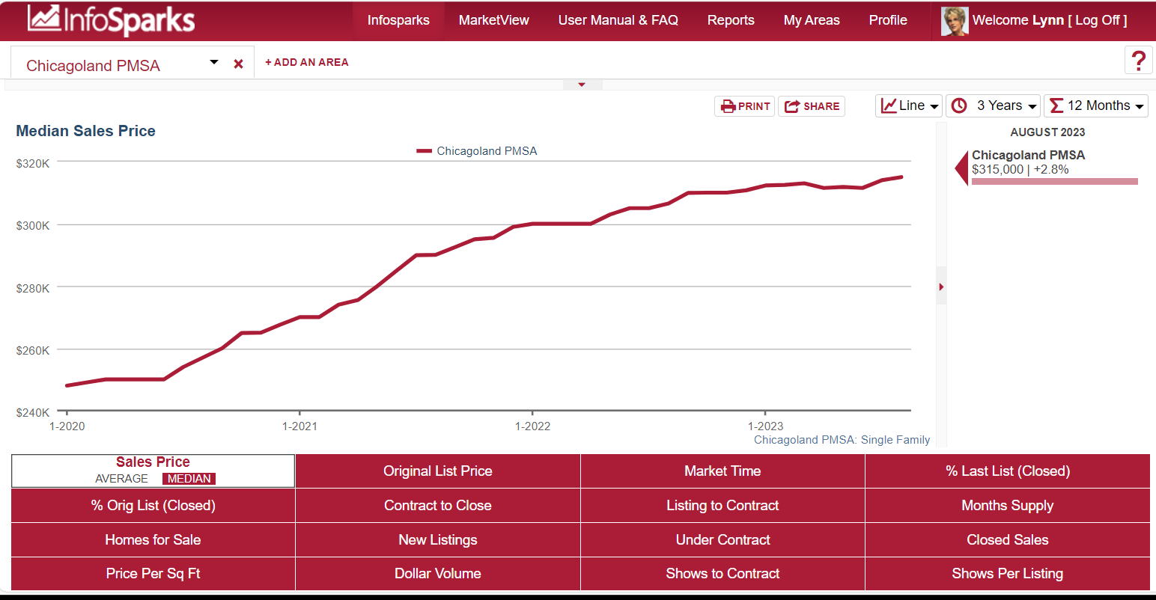
Local Median Sales Price
Source: InfoSparks, Chicagoland PMSA, August 2023
127
Notes:
EDIT SLIDES
Replace these slides with applicable ones from your marketplace. If you are teaching in an area where you do not have access to the MLS – use your stats and have them relate their market to what you show

Slide 127
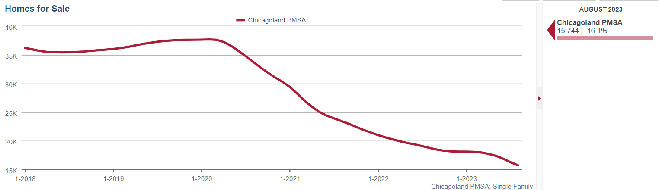
Homes for Sale
Source: InfoSparks, Chicagoland PMSA, August 2023
128

Slide 128
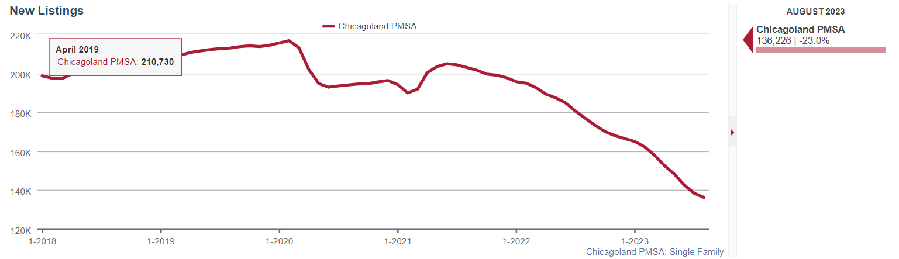
New Listings
Source: InfoSparks, Chicagoland PMSA, August 2023
129

Slide 129
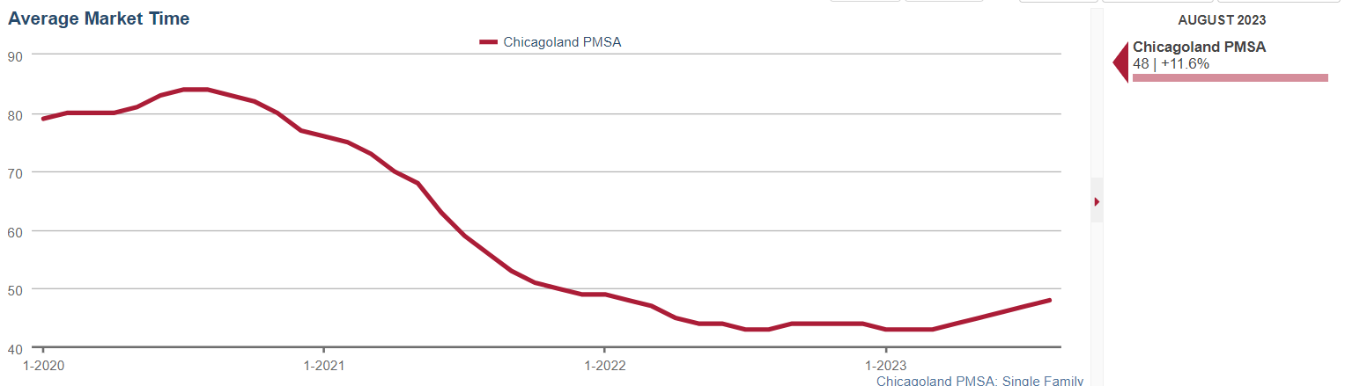
Market Time
Source: InfoSparks, Chicagoland PMSA, August 2023
130

Slide 130
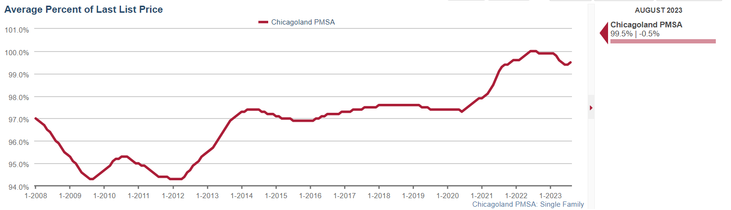
Percentage of List Price Received
Source: InfoSparks, Chicagoland PMSA, August 2023
131

Slide 131
Absorption Rate – MSI
Sellers Market
Less than 4 months supply
Balanced Market
4 – 6 months supply
Buyers Market
6+ months supply
132

Slide 132
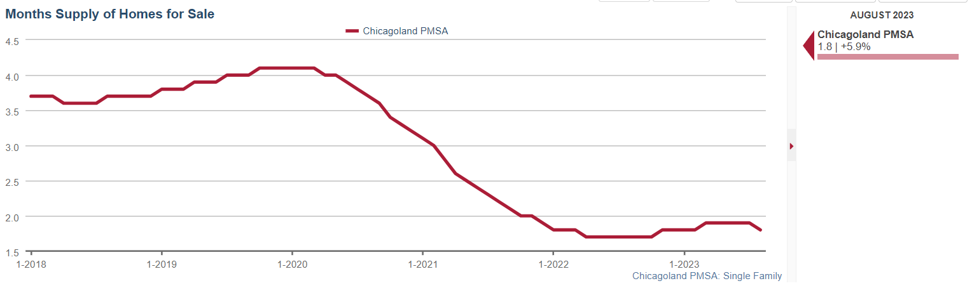
Absorption Rate – Months Supply
Source: InfoSparks, Chicagoland PMSA, August 2023
133

Slide 133


What Type of Market?
Buyers Market
Sellers Market
New Home Price $
New Home Price $$$
134

Slide 134

Buyers Market
Buyers are in control and, if anything, we need to help them not insult the seller with a ridiculously low offer.
135

Slide 135

Sellers Market
In a sellers’ market the ‘win’ is not on the price
The ‘win’ for the buyers is getting the house
You can’t wait until you’re ready to write an offer to have this discussion
136

Slide 136

Sellers Market
If they can only go to $300,000 – showing listings at $325,000 sets the wrong expectations
You might consider starting with $280,00 - $290,000 to give them room to go up
You need to be aggressive with offers and go for the ‘win’
137

Slide 137
Educate the Buyer – The A-A-I Consultation Session
Ask the buyer questions:
Working with other agents?
Buyer's motivations?
Currently renters or owners?
Home to sell before buying?
Interview other buyer representatives?
Search efforts to date?
Length of search so far?
Which websites have been the most helpful?
Properties seen and liked?
What kept you from buying?
Property needs, wants, locations, price parameters?
Time frame, critical dates?
Down payment and financing plans?
Budget for mortgage payments?
Potential financing issues, credit problems?
Mortgage preapproval?
Eligibility for VA financing of other mortgage programs?
Concerns about the process or market?
Answer buyer's questions:
How will we communicate?
How will you help find the right property?
Sources you use to find properties?
How will you identify “new on the market” properties?
Will you help me find out about a property’s condition?
How are you compensated?
Do you represent the sellers?
﻿﻿﻿﻿What if I find a home on my own?
How can I be sure you’ll get me the best deal?
If your commission depends on the price of the property?
What are the steps in the purchase process?
Will you help me compare prices?
Market conditions — buyers’ or sellers’ market?
Can you provide a list of lenders, repair contractors, other services?
Can you help me estimate how much I can afford?
Inform buyer about process
﻿﻿Agency disclosure
﻿﻿What to do if another agent approaches the buyer
﻿﻿Caution not to share confidential information before agreeing to work together
﻿﻿Market conditions and realities
﻿﻿Realistic expectations for property search
﻿﻿Advantages of buyer representation
﻿﻿Your credentials, experience, specialties, and services
﻿﻿Your performance guarantee, if offered
﻿﻿Strategy for finding the right property
﻿﻿Importance of punctuality for showing appointments
﻿﻿Property viewing protocol
﻿﻿Community information sources
138

Slide 138
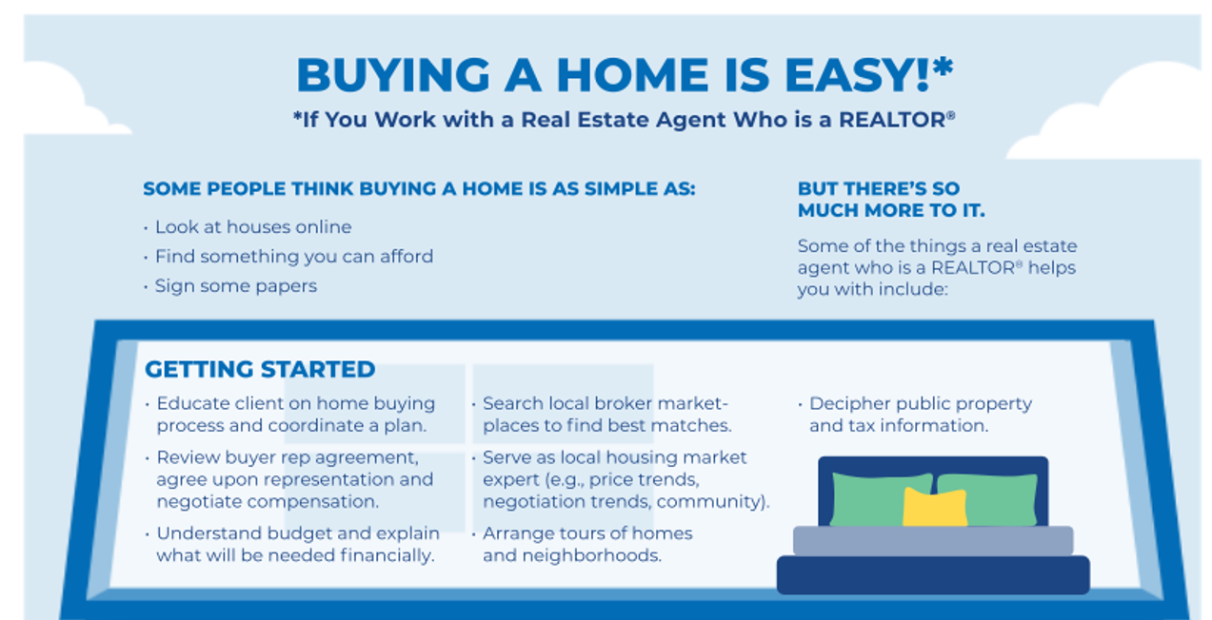
Center for REALTOR® Development ©2024
139
Notes:
This is an NAR publication– do we want to include it? I believe it is on competition.realtor

Slide 139

Center for REALTOR® Development ©2024
140

Slide 140
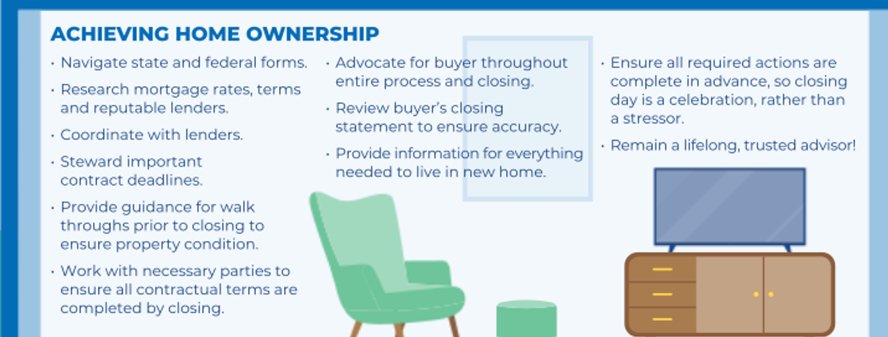
Center for REALTOR® Development ©2024
141

Slide 141
Do You Want To Represent This Buyer?
Certain Clients Drain Your Time and Resources
Unmotivated
Potentially unqualified
Unrealistic
Inconsiderate
Questionable loyalty
Asks you to perform unlawful acts
142

Slide 142

Ending Client Relationships
Sometimes you have to end a client relationship
Be professional. Have a plan
“It looks like you need more time to think through your decision. Let’s put things on hold for a while”
“I am sorry that our time searching did not yield your desired results”
143

Slide 143
Key Point Review —Module 2
Both the agent and the buyer seek the right relationship to facilitate a home purchase
A buyer consultation involves asking questions, answering questions, and informing the buyer about the process
For the buyer to choose you as their agent – you will need to communicate your unique value proposition
144
Notes:
Course Notes:
Review the scenario presented in A Day in the Life of a Buyer’s Representative. Use this scenario as the basis for discussion of the module objectives.

Slide 144
A Day in the Life of … A Buyer’s Rep
Your opportunity to review Module 2 concepts
145

Slide 145

Module 3: Buyers Representation Agreement

Slide 146
Module 3 Learning Objectives
Know the four contracts in real estate and how they relate – and do not relate – to each other
Understand the importance of using a buyer representation agreement
Be knowledgeable and prepared to explain the benefits of buyer representation agreements
147

Slide 147
Four Contracts in Real Estate
Listing
Agreement
Buyer Rep Agreement
What is in an agreement is only binding on the parties to that agreement
Only parties to an agreement have the right to know the agreement’s terms
Only people who can benefit by or be held to a contract are the parties
Offer of Compensation
Sales Contract
148

Slide 148
Listing Agreement
Between seller and listing brokerage
Creates relationship
Spells out duties and compensation
Buyer Rep Agreement
Between buyer and buyer brokerage
Creates relationship
Spells out duties and compensation
Offer of Compensation
Between brokerage companies
Communicated through MLS
Acceptance of offer occurs through performance
Sales Contract
Between buyer and seller
Spells out all obligations
Brokers and agents not parties
149

Slide 149

Is a Written Buyer Representation Agreement Required?
Some states, yes.
Some states recognize unwritten agreements.
Note: if you work with buyers as clients without a written representation agreement, you are still obligated to comply with state laws and the REALTOR® Code of Ethics.
150

Slide 150
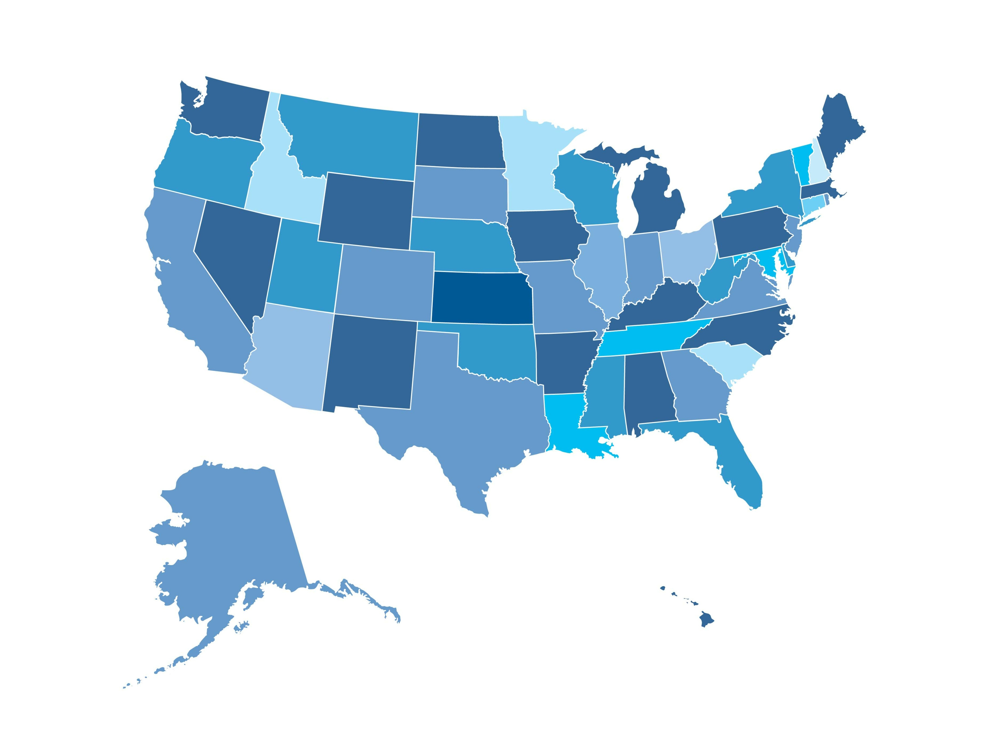
What are your state requirements? Not all provisions are in all contracts Required elements not always the same in each state
151

Slide 151
Let’s Talk
Benefits of the Agreement
Outlines Mutual Responsibility
Limits Role
Defines Loyalty
Ensures You’ve Disclosed All That You Must
Required By Law
Shows Evidence of Agreement and Disclosures
152
Notes:
Not all contracts are the same. These are the basic elements. If you choose to use the contract used in your marketplace you can replace these slides with ones that show your contract and discuss it specifically.

Slide 152
Formalizing the Relationship
Getting a signed buyer representation agreement is important:
Clarifies duties to your buyer client
Protects the parties' financial interests
Protects you from potentially serious legal consequences
Even if your state does not require a written agreement – it benefits all parties by solidifying the relationship, duties, and compensation
153

Slide 153


Buyer Agreement
Exclusivity
Exclusive
Brokerage owed compensation regardless of who buyer purchased property through or from
Non-Exclusive
Allows buyers to work with as many brokerages as they choose
154
Notes:
Use the Buyer Rep Agreement used in that marketplace or the one that is in the Resources section as an example. Remind them that it is a sample only and should not be used without Brokerage company’s permission.

Slide 154
Area
Area
Be reasonable but not restrictive
Encompass all areas within buyer’s parameters
Market area rather than specific towns
Some agreements have price and type of property – be careful here. If you put ‘$350 - $400,000, 2-story’ and they buy a $349,000 split-level – they may not owe you any compensation
155

Slide 155
Duration
Can depend on market
Negotiate a term that both you and your client are comfortable with
Can always be extended
156

Slide 156
Compensation After Expiration
If buyer purchases a property you showed them during an agreed upon period following expiration, you may still be entitled to compensation
157

Slide 157
Services
Agent’s Services
Show properties in MLS
Show properties buyers find
Do CMA and market statistics
Explain forms and contracts
Prepare offer
Negotiate price and terms
Coordinate home inspection
Work with lender on appraisal issues
158

Slide 158
Services
Buyer Role
Provide agent with home search parameters
Work exclusively with agent to identify and acquire real estate
Bring to agent’s attention any unlisted property they wish to see
Supply relevant financial information
Be available upon reasonable notice and at reasonable hours to inspect property
159

Slide 159
Other Buyers
May be showing same property to other buyers
Discuss how you will handle contemporaneous/simultaneous offers
160

Slide 160
Dual Agency
Dual Agency is state specific – check your state requirements
Put Dual Agency Disclosure in agreement
If separate, discuss potential for dual agency and when you will ask for permission/signatures
161

Slide 161
Nondiscrimination
Follow your state requirements for language that must be in all brokerage agreements regarding fair housing
Center for REALTOR® Development ©2024
162

Slide 162
Assignment/ Cancellation
Obligates buyer if they try to subvert this agreement by having someone else buy it and assign the contract or sell it to the actual buyer
Under what circumstances can either party cancel the agreement
Center for REALTOR® Development ©2024
163

Slide 163
Compensation
Should specify how much the real estate brokerage will be paid for the services to the buyer and where that fee will come from
Should clearly state the circumstances under which the buyer will owe compensation
Agreements may state the buyer will owe the difference between the agreed-upon compensation and any offer of compensation from listing brokerage
Center for REALTOR® Development ©2024
164

Slide 164
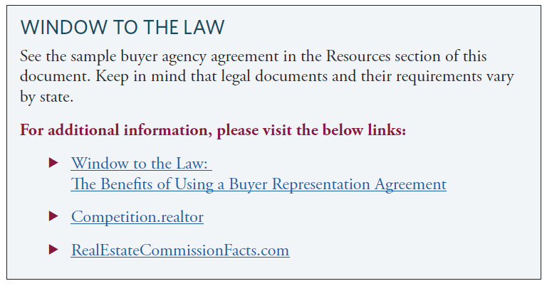
Center for REALTOR® Development ©2024
165

Slide 165
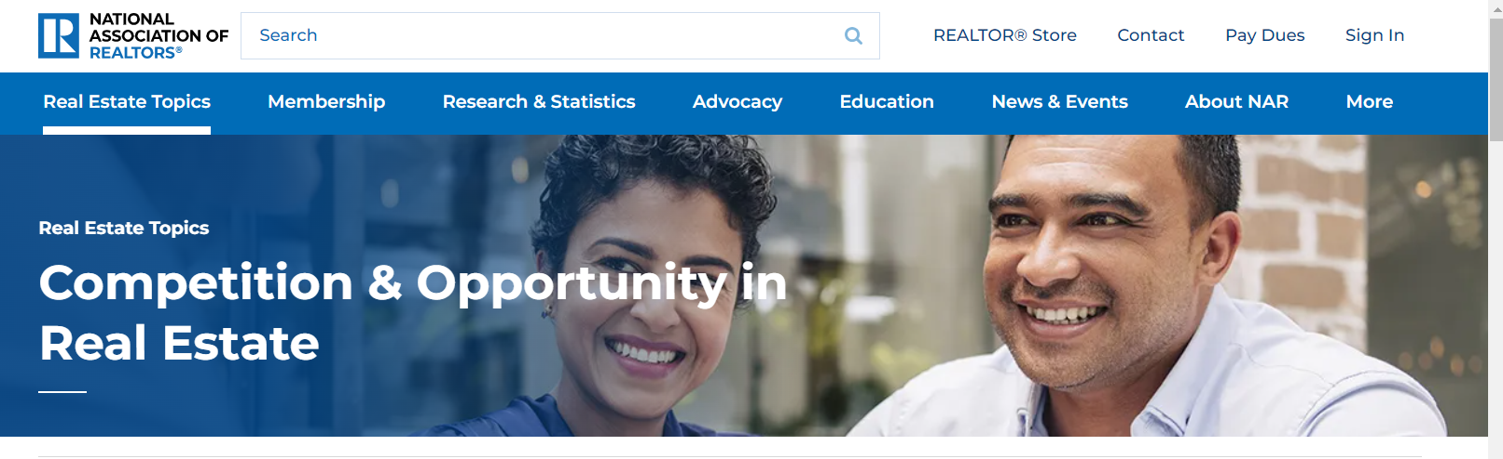

competition.realtor
Center for REALTOR® Development ©2024
166
Notes:
Slides 178 thru 180 are extra slides showing what is available on competition.realtor

Slide 166
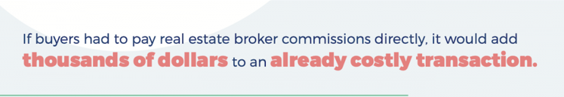
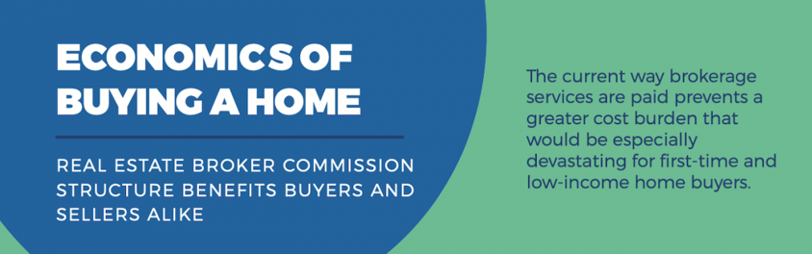
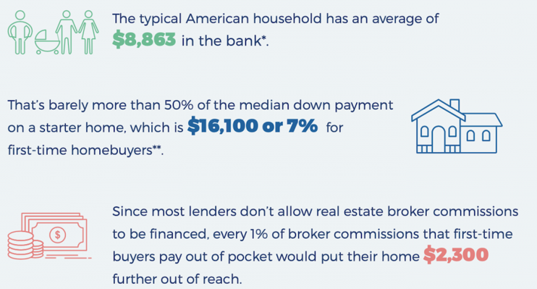
competition.realtor
Center for REALTOR® Development ©2024
167
Notes:
We have put examples of what is on competition.realtor on the slides – they are not in their manual.

Slide 167

Center for REALTOR® Development ©2024
168

Slide 168
Let’s take a deeper dive into the compensation issues

Slide 169
Settlement Agreement Resolving Nationwide Home Seller Claims
The agreement would release
NAR
over one million NAR members
all state/territorial and local REALTOR® associations
all association-owned MLSs
all brokerages with an NAR member as principal that had a residential transaction volume in 2022 of $2 billion or below (NAR fought to include all member brokerages in release)
from liability for the types of claims brought in these cases on behalf of home sellers related to broker commissions.
No admission of liability.
NAR will pay $418 million over approximately four years.
NAR’s membership dues for 2024 will not change because of this payment.
Center for REALTOR® Development ©2024
170

Slide 170
Settlement Agreement Policy & Practice Changes
Changes will go into effect mid-July 2024
NAR has agreed to put in place a new rule prohibiting offers of compensation on the MLS.
Offers of compensation could continue to be an option consumers can pursue off-MLS through negotiation and consultation with real estate professionals.
Sellers can offer buyer concessions on an MLS (for example, concessions for buyer closing costs).
NAR has agreed to put in place new rules requiring MLS participants working with buyers to enter into written representation agreements with buyers.
NAR continues to believe that cooperative compensation and NAR’s current policies are good things that benefit buyers and sellers by promoting access to property ownership, particularly for lower- and middle-income buyers who can have a difficult-enough time saving for a down payment.
With this settlement, NAR is confident it and its members can still achieve all those goals.
Center for REALTOR® Development ©2024
171

Slide 171

Compensation Options
Percentage of Sale Price
Flat Fee
Hourly Rate
Retainer
Center for REALTOR® Development ©2024
172

Slide 172
Code of Ethics
What Are the Ethical Standards Related to Compensation?
REALTORS® must abide by the Code of Ethics and Standards of Practice in all transactions
Clients
Customers
Seller and their agent
Other professionals
Center for REALTOR® Development ©2024
173

Slide 173
Code of Ethics
Article 16, Standard of Practice 16-1
Article 16 is not intended to prohibit aggressive or innovative business practices which are otherwise ethical and does not prohibit disagreements with other REALTORS® involving commission, fees, compensation, or other forms of payment or expenses.
(Adopted 1/93, Amended 1/95)
Center for REALTOR® Development ©2024
174

Slide 174
Code of Ethics
Standard of Practice 3-1
REALTORS®, acting as exclusive agents or brokers of sellers/ landlords, establish the terms and conditions of offers to cooperate.
Unless expressly indicated in offers to cooperate, cooperating brokers may not assume that the offer of cooperation includes an offer of compensation.
Terms of compensation, if any, shall be ascertained by cooperating brokers before beginning efforts to accept the offer of cooperation.
(Amended 1/99)
Center for REALTOR® Development ©2024
175

Slide 175
Code of Ethics
Standard of Practice 1-5
REALTORS® may represent the seller/ landlord and buyer/tenant in the same transaction only after full disclosure to and with informed consent of both parties.
(Amended 1/99)
Center for REALTOR® Development ©2024
176

Slide 176
Code of Ethics
Standard of Practice 16-16
REALTORS®, acting as subagents or buyer/tenant representatives or brokers, shall not use the terms of an offer to purchase/lease to attempt to modify the listing broker’s offer of compensation to subagents or buyer/tenant representatives or brokers nor make the submission of an executed offer to purchase/lease contingent on the listing broker’s agreement to modify the offer of compensation.
(Amended 1/04)
Center for REALTOR® Development ©2024
177

Slide 177
Display of offer of compensation – 8.8
MLS’s must include offer of compensation in the data feeds sent to participants
Must allow brokerages – at their discretion – to share offers of compensation on their websites
Must be accompanied by disclaimer staying that the offer is made only to participants of the MLS where the listing is filed
Center for REALTOR® Development ©2024
178

Slide 178
Non-filtering of Listings – 8.85
MLS participants must not – and MLSs must not enable – the ability to filter out or restrict listings that are searchable by and displayed to consumers based on:
Compensation offered to cooperating broker
Name of brokerage
Name of agent
Center for REALTOR® Development ©2024
179

Slide 179
SOP 12-1
REALTORS® must not represent that their brokerage services to a client or customer are free or available at no cost to their clients, unless the REALTOR® will receive no financial compensation from any source for those services. (Amended 1/22)
Center for REALTOR® Development ©2024
180

Slide 180

REALTOR® Code of Ethics – Compensation
Duties to Clients & Customers
Standard of Practice 1-12
When entering into listing contracts, REALTORS® must advise sellers/landlords
The REALTOR®’s company policies regarding cooperation and the amount(s) of any compensation that will be offered to subagents, buyer/tenant agents, and/or brokers acting in legally recognized non-agency capacities;
the fact that buyer/tenant agents or brokers, even if compensated by listing brokers, or by sellers/landlords may represent the interests of buyers/tenants
any potential for listing brokers to act as disclosed dual agents
Center for REALTOR® Development ©2024
181

Slide 181
REALTOR® Code of Ethics – Compensation
Duties to Clients & Customers
Standard of Practice 1-13
When entering into buyer agreements, REALTORS® must advise buyers/tenants
The REALTOR® policy regarding cooperation
The amount of compensation to be paid by the client
Potential for additional or offsetting compensation from other brokers, sellers, or other parties
Any potential for the buyer representative to act as a disclosed dual agent
Center for REALTOR® Development ©2024
182

Slide 182
Disclosure of Compensation

Slide 183
Listing Compensation
Buyer Brokerage Compensation
Total
Compensation
Compensation is two parts added together to make the whole
Part is for the listing office and what they do for the seller
Part is for the buyer brokerage for bringing a ready, willing and able buyer for a successful transaction
Center for REALTOR® Development ©2024
184

Slide 184
Dialog with Sellers
Explain the charge of $xx for services provided in the transaction
Talk about the offer of compensation to the brokerage that brings in the buyer
Center for REALTOR® Development ©2024
185

Slide 185
Negotiate It
Co-op compensation discussed with seller
Seller makes final decision prior to signing the listing agreement
Listing brokerage offers the agreed upon amount of co-op compensation
Prepare seller for buyer’s options depending on their decision
Center for REALTOR® Development ©2024
186

Slide 186
Compensation Details
If, during the term of this contract, Buyer enters into a contract to acquire real estate and such contract results in a closed transaction, Buyer agrees to pay Brokerage firm a Brokerage Fee of $ or % of the purchase price.
Center for REALTOR® Development ©2024
187
Notes:
Repeated this to remind them of what most agreement say.

Slide 187
Compensation Details
The Buyer Broker will make every effort to collect the Brokerage Fee from the listing broker. If the Brokerage Firm is not being offered compensation as a cooperating Broker, or compensation being offered does not cover the Brokerage Fee, Agent will inform Buyer prior to showing the property.
Center for REALTOR® Development ©2024
188

Slide 188
Buyer Agent – With Buyer Rep Agreement
Establish compensation at time of agreement
You and the buyer agree
Not subject to seller and listing agent agreement
Compensation is negotiable
Disclose what buyers may owe prior to showing
189

Slide 189

Buyers have choices
Choose to not look at the property
Pay their brokerage at closing
Ask seller to pay as part of sales contract
190

Slide 190
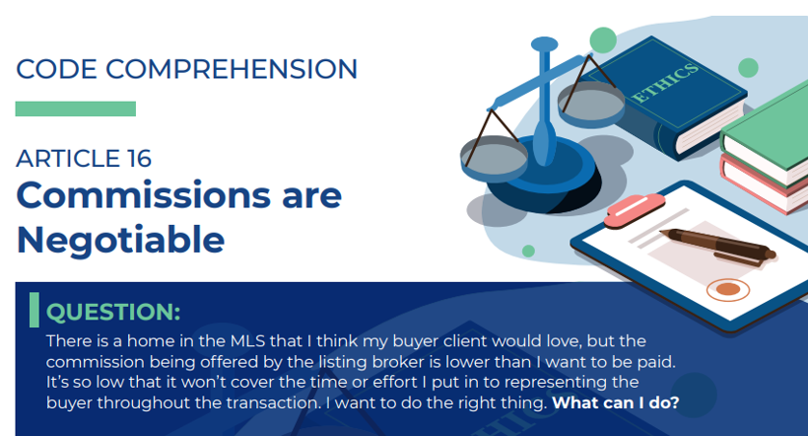
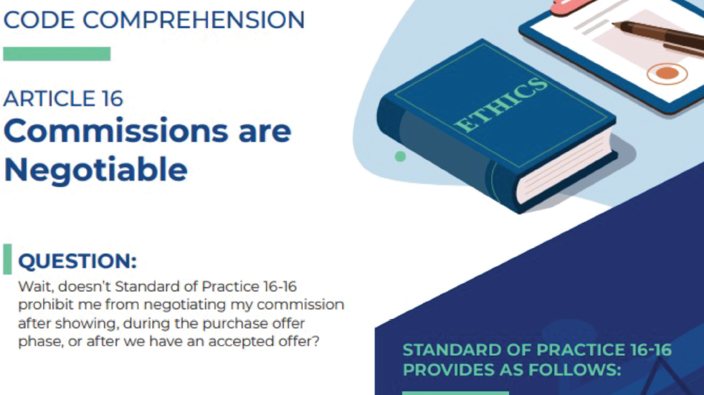
191

Slide 191
If Buyer Is Paying Brokerage
Prior to submission of offer, listing brokerage and cooperating brokerage may agree in writing to modify any offer of compensation
Brokers/agents should not use terms of offer or to modify cooperative compensation or make the submission of offer contingent on modification
Ensure clients are making an informed decision
Buyer can agree on sales price, concessions, credits with seller in purchase and sales agreement
192

Slide 192
Buyer Agent – No Written Agreement
Disclose range of compensation to buyers prior to showing
Prior to writing offer – disclose actual offer of compensation
Show all properties that fit buyers needs – regardless of compensation
193

Slide 193
Buyer Agent – No Written Agreement
Work for whatever the seller/listing office is offering
Tell buyer they can look at it with someone else
Have buyer sign buyer rep agreement – see above!
194

Slide 194
Bottom Line Impact
Buyers don’t have extra cash
Lenders won’t let them add it to the mortgage
If buyers do pay out of pocket, they may have less to offer seller
195

Slide 195
Additional Compensation Issues

Slide 196
Offer is MORE than agreed
Should be addressed in your buyer agreement
Must disclose to buyer if making more than what is in buyer rep agreement
Can be addressed in buyer rep agreement to provide for “range” of acceptable compensation
“If the fee collected is between _____% and _____% of the purchase price, the Buyer’s responsibility for compensation will be deemed to be satisfied”
Buyer can ask listing brokerage to modify offer of cooperative compensation to pay only what is in Buyer Rep Agreement
197

Slide 197
Seller and Buyer Addressing Broker Comp in Contract
Seller and Buyer can agree to address compensation in terms of an offer
Useful when working FSBO, short sale, no offer of compensation, or supplement is needed
Important contract considerations:
Seller and Buyer agree to Sales Price, including costs of transaction, concessions and credits
Seller and Buyer acknowledge whether they are represented and identify brokerage(s)
Seller and Buyer acknowledge whether any offer of compensation is supplemented, modified or rejected and acknowledge responsibility for paying compensation pursuant to separate brokerage agreements
What happens if seller rejects or counters?
198

Slide 198
How Does Compensation Work for Listings Not in the MLS?
Get compensation in writing from Listing Managing Broker
Have the written offer of compensation prior to showing the property
Use buyer representation agreements
199

Slide 199
How Does Compensation Work for FSBOs?
Ask seller to pay a commission for bringing a ready, willing, and able buyer to close the transaction
Include amount of your compensation and ask seller to credit the buyer at closing so buyer can pay
Buyer can include compensation language in purchase contract
200

Slide 200
How Does Compensation Work With VA Buyers?
VA does not allow a buyer to directly compensate a buyer's representative
Offer of compensation from the listing broker
Cannot exceed offered commission
201
Notes:
Course Notes:
Further information for assisting veterans seeking VA loans is available at https://www.benefits.va.gov/homeloans/realtors.asp.

Slide 201
When Buyers Won’t Sign
Recommended you have criteria for which buyers you will represent and those you will not, as mentioned before
Check company policy on requirement for using buyer representation agreement
If buyer won’t sign and neither the state nor your brokerage require an agreement be signed, you have some options
202

Slide 202
When Buyers Won’t Sign
Short-term agreement
Nonexclusive
Trial basis
Specific property
Permit buyer to cancel
Remember to apply your criteria the same for all buyers to avoid any appearance of unequal treatment
203

Slide 203
Key Point Review — Module 3
A buyer’s representation agreement lays the foundation for buyer loyalty and compensation
Educate your clients on the value you provide, how compensation is paid, and how this serves your clients’ interests
The buyers have choices on how they facilitate the compensation to their brokerage company
204
Notes:
Course Notes:
Review the scenario presented in A Day in the Life of a Buyer’s Representative. Use this scenario as the basis for discussion of the module objectives.

Slide 204
A Day in the Life of … A Buyer’s Rep
Your opportunity to review Module 3 concepts
205

Slide 205

206

Slide 206
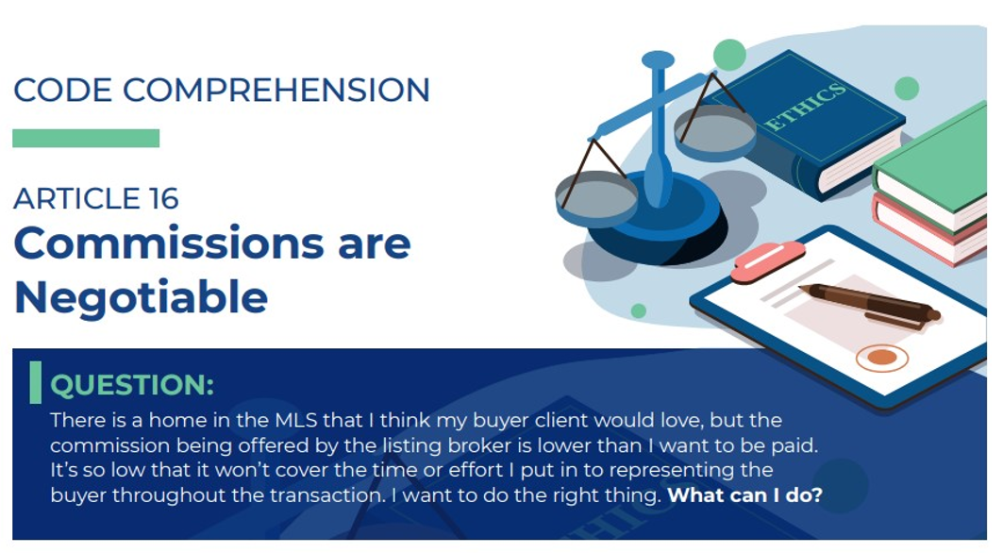
207

Slide 207
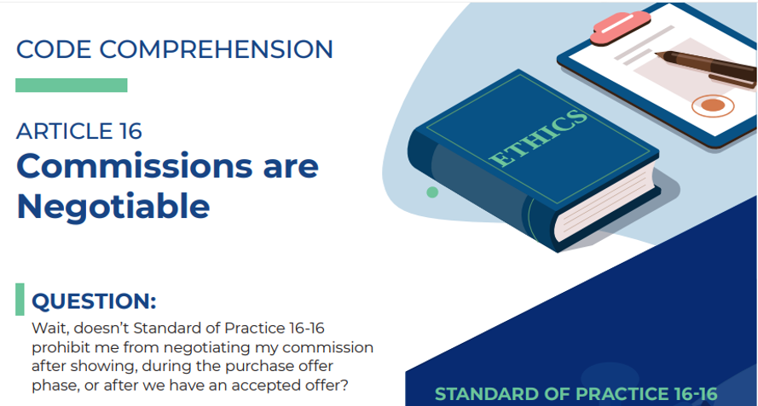
208

Slide 208

Module 4: Search-Showing- Selecting Process

Slide 209
Module 4 Learning Objectives
Identify ways to manage buyer’s expectations
Show properties in a manner that presents clients with the best opportunity to view properties
Follow federal, state, and local fair housing laws when selecting and showing properties
210

Slide 210

Searching for Properties
Buyers want to see everything
Our job – find the right matches
Sometimes they know it right away
Sometimes it takes time
We must be efficient and effective – let’s look at how we can do that!
211

Slide 211

Managing Expectations
Our job – reduce their stress
Listen – ask questions – their needs and wants can change
212

Slide 212

Managing Expectations
Provide or remind them of overview of transaction
Focus on their priorities
Provide them with ways to take notes on what you show them
213

Slide 213

Managing Expectations
Focus on their higher priorities
Constantly refer to their list of wants and needs
Help them look at tradeoffs to meet their goals
214

Slide 214
Active Listening

Slide 215

Pay Attention!
Listen to their wants and needs and their concerns and plans for the future
Pay attention to body language and emotional cues
Write down what they say
The more you learn the better job you can do
216

Slide 216
Don’t Judge!
Guide them through their process – don’t dictate yours
Your tastes, priorities and needs are not theirs
Our job – find the right home for them
217

Slide 217

Reflect
Confirm you understand
If unclear – ask them to repeat
Ask clarifying question
Ensures you and clients are on same page
Let them know they are being heard
218

Slide 218

Clarify
Do not be afraid to ask them to repeat something
Better to get it clear than misunderstand
Don’t have to ‘get it’ right away – some clients struggle with communicating their needs
219

Slide 219

Check In
If search is taking a while – check in and verify they have not changed parameters
Extended searches lead to frustration and things can change
You may not be aware of changes if you don’t take the time to actively check in and find out what they’re thinking and feeling
220

Slide 220
Property Comparison Worksheet For Buyers
 | Home #1 | Score | Home #2 | Score | Home #3 | Score
Pricing/Cost
Asking Price
Price/Sq. Ft.
Property Taxes
Monthly Mortgage
Est. Insurance
HOA Fees
Monthly Utilities
Total Monthly Cost
General Features
Year Built
Square Footage
House Style
Lot Size
# of rooms
# of bedrooms
# of bathrooms
Basement
Garage
Attic
221

Slide 221

Property Search Considerations
Utilize All Your Resources
MLS
Websites – social media
Networking
Phone, email and mail
New construction
Distressed properties
Advertise buyer’s interests
Auctions – FSBO’s – Drive around
222

Slide 222
Searching for FSBO Opportunities
Make productive contact with seller
Inform seller you’re an agent with qualified buyer
Assure seller that you are not looking to list home
Ask if seller is willing to offer compensation for you bringing a ready, willing and able buyer to close a successfully transaction
If your client is compensating you, don’t mention fee to seller
223

Slide 223

Realtors Property Resource®
Member benefit; already included in dues you pay to the National Association of REALTORS®
RPR® reports can be viewed online or downloaded
You can generate a full-color report with your contact information and brand within minutes to email or present to your client
224

Slide 224
Realtors Valuation Model®
Available if your MLS participates/shares data
Create, download, share RPR® reports from your computer, smartphone, tablet
Register and take RPR® for a test drive.
225
Notes:
Course Notes:
The Realtors Valuation Model® (RVM®) can aggregate valuation data from MLS listings. If your MLS shares its data with RPR®, your reports will then also include values calculated by the RVM® from real-time, real-world data. Find out if your MLS shares data, register, and try the RPR® application at www.narrpr.com.

Slide 225
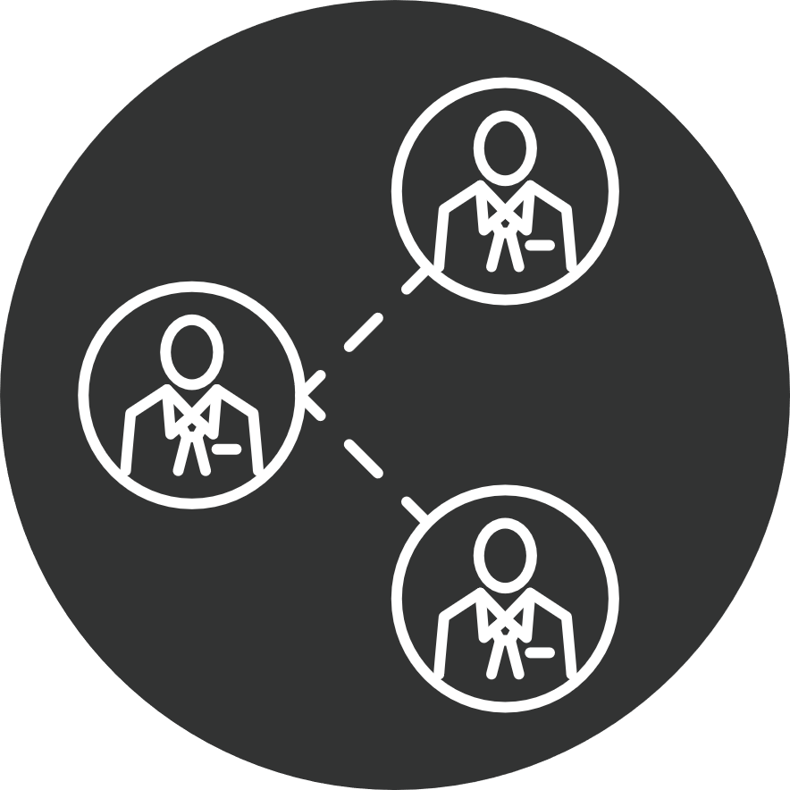
Share Information Responsibly
You have a legal and ethical obligation to share information responsibly
Know who you are sharing information with
Be careful that you are not sharing confidential information without permission
Know why you are sharing information
226

Slide 226
Showing Properties
Before
During
After
227

Slide 227
Showing Properties
Use Home Buyer’s Checklist
Advance list of properties
Review sample sales contract
Encourage buyer to eliminate distractions
Review expectations for appropriate behavior
Stress punctuality
Caution on per-square foot pricing
Recommend setting time after showings to discuss each property
Before
228

Slide 228
Showing Properties
Arrive on time
Announce your entry
Don’t take anything or damage the property
Leave it as you found it and follow showing instructions
No house is perfect - focus on home’s potential
List what can and cannot be changed
Check surroundings – can change house – can’t change location
Don’t smoke, eat, use the bathroom, or sit on furniture
Use informal name to help them remember
During
229

Slide 229
Showing Properties
Review Home Buyer’s Checklist; evaluate and compare properties
Compare cost of ownership
Choose second-look properties as preliminary to making an offer
Ask how each property meets their needs – ‘what did you think of this one?’
Do this after each property – have them ‘rank’ the ones they like
After
230

Slide 230
Be Mindful of Technology Use
Ask seller’s permission before taking interior photos or video
NEVER post photos/comments on social media
Comments can get back to the seller
May harm the buyer’s negotiating leverage
Don’t show strong reactions — there may be surveillance cameras
Know state laws regarding use of any recording devices
231
Notes:
Course Notes:
You can learn more about video and audio surveillance issues by viewing the “Window to the Law” series on the NAR website. https://www.nar.realtor/videos/window-to-the-law

Slide 231
Standard of Practice 3-9
REALTORS® shall not provide access to listed property on terms other than those established by the owner or the listing broker. (Adopted 1/10)
Cannot give buyers lockbox access without sellers' permission
Must supervise buyers inside a property
Must show during appointment time
Agent who made appointment must show – cannot substitute
Must follow sellers’ requirements
Wear shoe covers, masks, etc.
232
Notes:
Couse Notes:
Ask students to complete Exercise 3-2 Create Your Own Showing Protocol. Share ideas with all participants.

Slide 232

Create Your Showing Protocol
Prepare buyers
Best tips
Top issues
Before
During
After
233

Slide 233
Selecting Properties Selecting Homes Ethically: Fair Housing Laws

Slide 234

Same information should be given to all buyers
Timing may be an issue
Showing clients where to access reliable school resources so they can do their own research is ok
School reports given when asked about demographics of an area is not ok
Offer range of home choices — it’s the buyer’s decision
Center for REALTOR® Development ©2024
235

Slide 235
Offer range of home choices — it’s the buyer’s decision
Seven federally protected classes:
Race, color, religion, sex, disability, familial status, and national origin
Some states include additional protected classes
Comply with the law that provides the greatest protection for the consumer
Center for REALTOR® Development ©2024
236

Slide 236
What additional protected classes does your state or city have?

Slide 237
Statement of Fair Housing Policy and the Buyer Representative Agreement
Should include language that the company is committed to equal housing opportunity
Example:
It is the policy of [firm name] to abide by all local, state, and federal fair housing laws and not discriminate against any individual or group of individuals. The agent may not lawfully disclose the racial, ethnic, or religious composition of any neighborhood, community, or building, nor whether persons with disabilities are housed in any home or facility, except that the agent may identify housing facilities meeting needs of a disabled buyer.
Center for REALTOR® Development ©2024
238

Slide 238
Article 10 SOP 10-5
REALTORS® shall not be parties to any plan or agreement to discriminate against a person or persons on the basis of race, color, religion sex, disability, familial status, national origin, sexual orientation or gender identity. Amended 1/23
REALTORS® must not use harassing speech, hate speech, epithets, or slurs based on race, color, religion, sex, disability, familial status, national origin, sexual orientation, or gender identity.” Adopted 11/20
Center for REALTOR® Development ©2024
239

Slide 239

Sex Discrimination Includes Sexual Orientation
The FHEO – Federal Office of Fair Housing and Equal Opportunity – is responsible for and will investigate all complaints of unequal treatment regarding the LGBTQ+ community in housing
This is an Executive Order and not an amendment to the Fair Housing Act
Learn more online
Center for REALTOR® Development ©2024
240

Slide 240
LGBTQ+
Great information on the LGBTQ+ Real Estate Alliance’s report “How Discrimination Affects the LGBTQ+ Community on the Journey to Homeownership and Beyond”
Center for REALTOR® Development ©2024
241

Slide 241

Center for REALTOR® Development ©2024
242

Slide 242
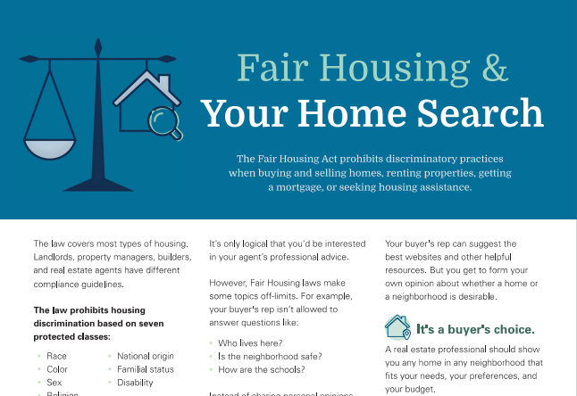
Buyer Handout on Fair Housing
Center for REALTOR® Development ©2024
243

Slide 243
Four Areas That Pose Risk
Screening — must use objective criteria that is applied to all buyers consistently, not selectively
Steering — the practice of influencing a buyer’s choice of communities based upon one of the protected classes under the Fair Housing Act
Advertising — must not favor or disfavor any particular demographic
Predatory lending — we do our clients a service by watching out for these practices
Center for REALTOR® Development ©2024
244

Slide 244
Questions We Shouldn’t Answer
What kind of people live in the neighborhood?
Is this a good place to raise a family?
We need to be the ‘source of the source’
We can and should direct buyers to resources to do their own research
Is this a safe neighborhood?
How are the schools here?
Can you show me a neighborhood with a large “X” population?
Center for REALTOR® Development ©2024
245

Slide 245
How Will You Respond?
What is the racial composition of the neighborhood?
Do you serve any areas that I would feel at home in?
What kind of people live in this neighborhood?
How are the schools in this area?
Do you think this property is in a safe area?
Again – refer clients to objective sources of information to research answers for themselves.
Center for REALTOR® Development ©2024
246
Notes:
Course Notes:
Discuss additional examples of how to respond to these types of questions. Role play the questions and answers to give students an opportunity to develop their own scripts.

Slide 246
Procuring Cause Issues

Slide 247
Buyer Agreement – Loyalty – Procuring Cause
A written agreement will not:
Keep buyer’s loyalty if you are not doing your job
Ensure you will get paid if you’re not doing your job
Ensure you are procuring cause
248

Slide 248
Procuring Cause
Basic Concepts
Whose actions “caused” the buyer to make the purchase?
Not “all the work I did for this client”
Not always the one who showed first
Not always the one who wrote the contract
Not always the one who has a buyer rep agreement
249

Slide 249
When and how was the first intro to the property made?
Ask buyers if they have looked at homes with other agents
Explain to your clients that looking at homes with others may negate your ability to assist them
Center for REALTOR® Development ©2024
250

Slide 250
Did the original intro start an uninterrupted chain of events?
Keep records of property showings, communications and interactions
Was the property shown to the actual purchaser?
Center for REALTOR® Development ©2024
251

Slide 251
Did the first agent stay in touch with the buyer?
Stay in contact with buyers between showings
Ask the buyer how they want to be contacted and how often. Keep records.
Center for REALTOR® Development ©2024
252

Slide 252
Did the second agent start a separate series of events that led to the sale?
Did buyer seek out the other agent? Why? Was it abandonment?
An Exclusive Buyer Rep agreement might prevent this
Center for REALTOR® Development ©2024
253

Slide 253
Did the second agent interfere? Were they aware of the prior showing?
Interference when agent knew of previous showing almost always ends in first agent being procuring cause
Keep good records
Prepare your buyers for this
Use a Buyer Rep Agreement
Center for REALTOR® Development ©2024
254

Slide 254
Did the first agent do something that caused the buyer to look elsewhere?
Examples:
Refusing to explain contract
Refusing to write low offer
Not making buyer aware of newly listed properties
Not being able to answer buyers’ questions about the house, the marketplace, the transaction
Center for REALTOR® Development ©2024
255

Slide 255
Key Point Review — Module 4
The protocol for showing properties addresses issues before, during, and after the showing
Buyer Representatives must familiarize themselves with local, state, and federal Fair Housing guidelines
The areas that pose danger of discrimination are screening, steering, and advertising
256

Slide 256
A Day in the Life of … A Buyer’s Rep
Your opportunity to review Module 4 concepts
Center for REALTOR® Development ©2024
257

Slide 257

Model 5: Offers and Negotiations

Slide 258
Module 5 Learning Objectives
Assist your client in formulating an informed and competitive offer based on objective valuation tools
Guide your client through the process of presenting an offer and negotiating with the seller to get the best outcome possible
259

Slide 259









Preparing the Buyer
Preparing to Shop
Moving In
1
Financing
Educate the buyer
Negotiating process
Forms and documents
Helps buyers manage emotions and make better decisions
Real Estate Buying Process
8
2
7
3
Closing the Sale
Finding the Right Broker
6
4
5
Negotiating
Finding the Property
Making an Offer
Center for REALTOR® Development ©2024
260

Slide 260
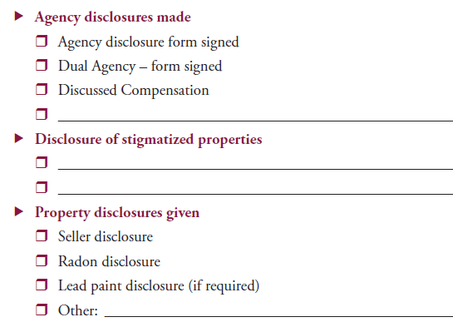
Buyer Checklist
Covers required disclosures
261
Notes:
This is obviously a sample – it will need to be customized for their marketplace. Designed to officially be used at time of writing contract it should be top of mind throughout the transaction.

Slide 261
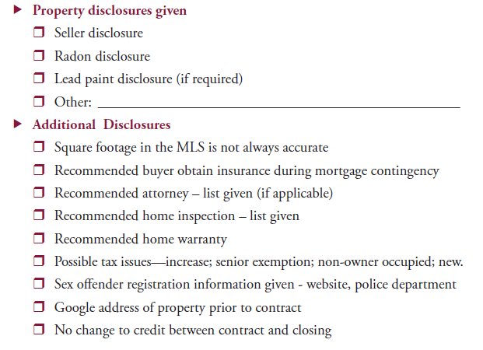
Buyer Checklist
Ensures you informed your buyers
262

Slide 262
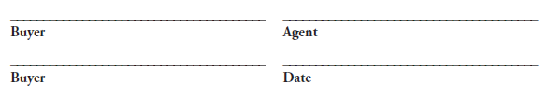
Buyer Checklist
Review with buyer at time of contract
Have them sign it
Memorializes your disclosures
You’ll need to customize for your market
263

Slide 263

Offer and Negotiating Process
Create a negotiating strategy – avoid ‘negotiating fever’
Provide an overview of the offer and negotiation process
Offers on 2 properties at same time – not allowed in most states without disclosure
Center for REALTOR® Development ©2024
264
Notes:
Course Notes:
This point is a good opportunity to remind clients of the benefits of working with a REALTOR® who is bound by a Code of Ethics and pledged to promote their best interests.

Slide 264

Managing Expectations
Prepare clients for reasonable expectations
What can they do?
What might the other party do?
Center for REALTOR® Development ©2024
265

Slide 265

Binding Contracts
Offer must be signed and delivered to be binding
Verbal promises are typically not legally enforceable
Everything should be in writing
Can be revoked or withdrawn up to the time there are signatures and delivery
Center for REALTOR® Development ©2024
266

Slide 266
Market Value
Winning offer starts with detailed Market Analysis
Use Realtors Property Resource® (RPR®) and the Realtors Valuation Model®(RVM®) discussed in Module 3
Be able to articulate difference between AVMs and CMA’s
If acting as disclosed dual agent, prepare CMA for both buyer and seller
Center for REALTOR® Development ©2024
267

Slide 267

Start Pricing Homes with Confidence
New logo to come?
The Pricing Strategy Advisor (PSA) certification provides a framework to help you determine a fair property market value and confidently advise your buyer and seller clients. In the course, you will learn how to:
Enhance your pricing skills
Select the best comps
Prepare insightful CMAs
Work constructively with appraisers
Guide clients through the process
Center for REALTOR® Development ©2024
268

Slide 268
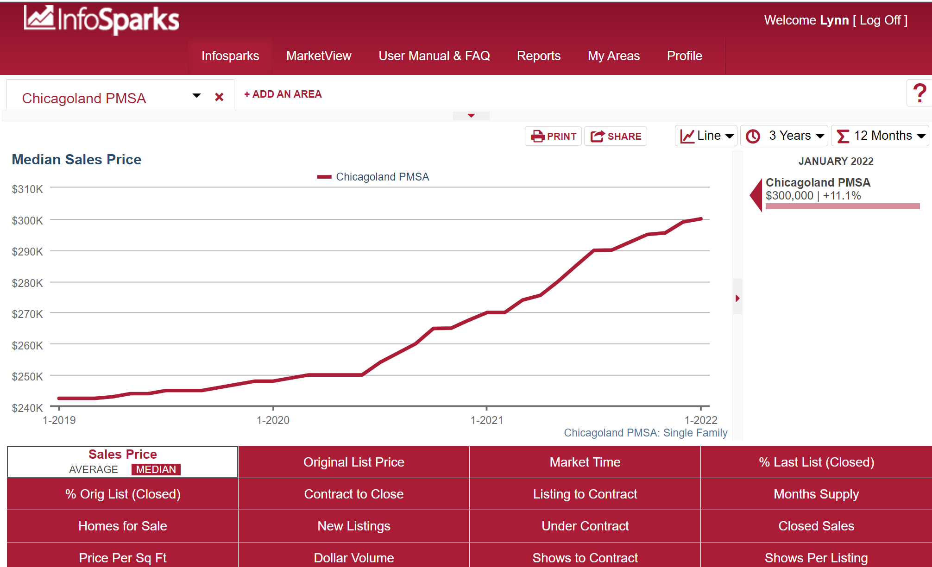
Update Market Information
Competition
Price trends
Supply and demand
Absorption rate
Average market time
Source: InfoSparks, Chicagoland PMSA, January 2022
Center for REALTOR® Development ©2024
269

Slide 269

Dual Agency
In most states – you will do a CMA for the buyer – one was done for the seller and they are to be treated equally
If you are doing same-agent dual agency it is recommended you use the same CMA you gave the seller – updated if needed
Center for REALTOR® Development ©2024
270

Slide 270

Formulating an Offer
Once you have updated and discussed current market conditions it’s time to move forward
Remind your client that the offer represents a legal contract
Advise buyer of seller’s options
Center for REALTOR® Development ©2024
271

Slide 271
Game Plan
Is the market with you or against you?
Are there competing offers?
Are the parties motivated?
What is your relationship with the other agent?
Center for REALTOR® Development ©2024
272

Slide 272
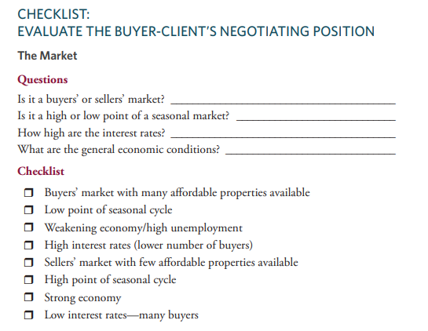
Center for REALTOR® Development ©2024
273

Slide 273
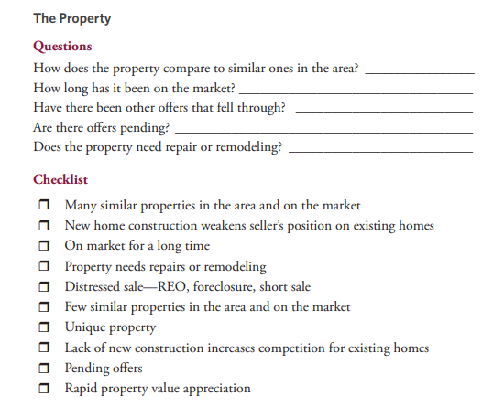
Center for REALTOR® Development ©2024
274

Slide 274
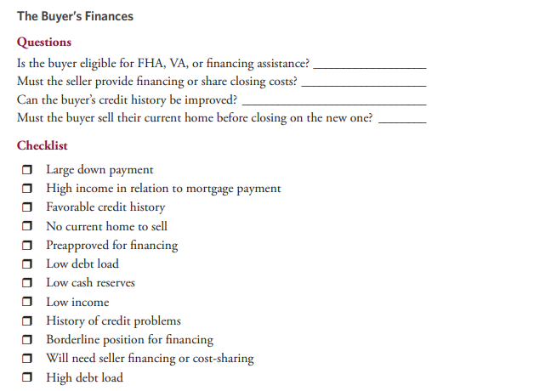
Center for REALTOR® Development ©2024
275

Slide 275
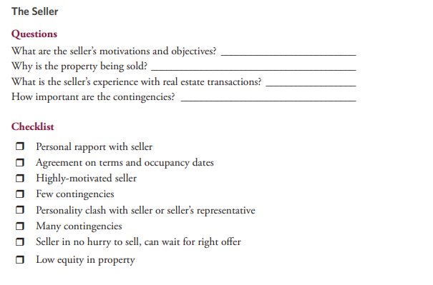
Center for REALTOR® Development ©2024
276

Slide 276
Everything we do depends on this
Know and use strategies for all market types
Buyers Market
Sellers Market
New Home Price $
New Home Price $$$
Center for REALTOR® Development ©2024
277

Slide 277
Strategies for a Buyers’ Market
Keep up-to-date on price adjustments
Request contingencies, allowances, or extras, such as a home warranty
Ask seller to help with closing costs
Shorten time for seller’s acceptance
Request a credit if inspection reveals needed repairs.
All cash or underwritten mortgage – benefit in all markets
Center for REALTOR® Development ©2024
278

Slide 278
Seller Concessions Could Include
Permitting buyer to move in quickly
Help with financing
Rent with option to buyer
Paying buyer closing costs and other fees
Paying for improvements
Center for REALTOR® Development ©2024
279

Slide 279
Strategies for a Sellers’ Market
Not all suggestions will work for every buyer or seller
Our job is to have enough ‘arrows in our quiver’ and know which one to use and when to use them!
Center for REALTOR® Development ©2024
280

Slide 280
What can buyers do?
Underwritten approval or waive mortgage contingency
Purchase ‘as-is’
Offer list price or more
More earnest money
Make first offer best
Center for REALTOR® Development ©2024
281

Slide 281
What can buyers or we do?
Pay for some seller items
Survey
Transfer taxes
Prorate at 100% – or less
Title charges
Remove contingencies
Inspection prior to contract
Do not require ‘broom clean’
Center for REALTOR® Development ©2024
282

Slide 282
What can buyers or we do?
What does seller need?
Allow seller to set closing date
Let seller stay after closing if they need time
Buy with reverse contingency
Be careful of comments when viewing property
Center for REALTOR® Development ©2024
283

Slide 283
Contingencies
The key is to be aware of the contingencies that are common in the area where the property is located
Examples:
Sellers’ paying buyer closing costs is NOT common everywhere
Earnest money – sometimes 5-10%+ of purchase price – submitted in 2 days
Attorney review
Inspections
Approval of financing
Sale of a current home
Receipt of HOA docs
Early occupancy
Must appraise
Home warranty
Personal property
Verification of affordable homeowner’s insurance
Verification of flood plain
Verification of permits and certificates of occupancy for improvements
Center for REALTOR® Development ©2024
284

Slide 284

Seller Concessions
Early buyer move-in
Help with financing
Rent with option to buy
Paying buyer’s closing costs and other fees
Paying for improvements
Center for REALTOR® Development ©2024
285

Slide 285

Too many contingencies can weaken offer
Agent’s duty to make buyers aware of available contingencies
Agent’s duty to explain ramifications of contingencies
Agent’s duty to recommend legal counsel if transaction warrants it
Center for REALTOR® Development ©2024
286

Slide 286
“You have to learn the rules of the game. And then you have to play better than anyone else.” — Albert Einstein
Center for REALTOR® Development ©2024
287

Slide 287
MLS Policy 7.73 – Presenting in Person
MLS rules allow buyer brokers to be present when offers are presented to seller
Seller can state in writing they do not want agents there
If you present in person
Create friendly atmosphere
Be sensitive to emotions
Avoid negative comments
Explain offer to seller
Leave so seller can discuss with listing agent
Center for REALTOR® Development ©2024
288

Slide 288
Submitting Offers
Time limit in offer?
Standard of Practice 1-6
REALTORS® shall submit offers and counteroffers objectively and as quickly as possible.
Notify listing agent you sent offer
What if you are getting no response from listing agent?
Listing agent cannot hold offers waiting for more – but seller can!
Center for REALTOR® Development ©2024
289
Notes:
Deadline in contract does not ‘make’ seller answer – contract is dead as of deadline
Use business email address and notify listing agent some other way than just sending a contract via email – going into spam or won’t be opened if it looks suspicious

Slide 289
Submitting Offers (Back-up Contracts)
Back-up contract does not give seller right to ‘kill’ first contract unless there is a ‘kick out’ in first one
Standard of Practice 1-7
REALTORS® shall continue to submit all offers and counter-offers until closing unless seller has waived this obligation in writing.
Must be written ‘subject to release of prior contract’ or seller needs to consult attorney
Not a ‘back-up’ unless signed by all parties and delivered – can and probably should have earnest money
Buyer needs to ensure they meet contingencies or seller could terminate contract
Center for REALTOR® Development ©2024
290
Notes:
They need to know how to create a back-up contract and how to work with them on the listing side.
Walk them thru how to set up office policies on the presentation of offers and creating back-ups.
If no attorney – agents could really mess this up by letting seller sign two ‘first-place’ contracts

Slide 290
Standard of Practice 1-8
REALTORS® shall submit to buyers all counteroffers until a contract is signed.
Shall show property after contract is signed if buyer requests but must recommend attorney advice if there is a question on whether first contract has been terminated.
All counteroffers must be conveyed to the buyers
No violation if showing buyer property after they have entered into a contract
Buyers must be released of first contract prior to entering contract on second property
Center for REALTOR® Development ©2024
291

Slide 291
Back-up Offers Become Contracts
Remember – buyer is in a contract
Cannot buy another property until the back-up time has expired without getting released
Center for REALTOR® Development ©2024
292

Slide 292
Perform Terms of Contract
Depending on what the contract requires, buyers could lose a property or forfeit their earnest money if they miss a required date or other term of the contract
Examples
Doesn’t tender earnest money on time
Doesn’t do mortgage application on time
Note: As with many other areas of the course – this can be state and contract specific
Center for REALTOR® Development ©2024
293

Slide 293
Change to 1-7
Upon written request of cooperating broker who submits an offer to the listing broker, the listing broker shall provide written affirmation as soon as practical stating that the offer has been submitted to the seller or a written notification that seller has waived obligation to see offer.
Change to 1-8
Upon the written request of the listing broker, the buyer’s broker shall provide, as soon as practical, a written affirmation to the listing broker stating that the counter- offer has been submitted to the buyers/tenants, or a written notification that the buyers/tenants have waived the obligation to have the counter-offer presented.
Center for REALTOR® Development ©2024
294

Slide 294
Confidentiality Standard of Practice 1-13
Buyers must be told:
. . . the possibility that sellers or sellers’ representatives may not treat the existence, terms, or conditions of offers as confidential unless confidentiality is required by law, regulation, or by any confidentiality agreement between the parties.
Center for REALTOR® Development ©2024
295

Slide 295
Note that state laws could overrule this article
Buyer agents must inform their buyers
Listing agent can disclose only with sellers permission
If it’s an Exclusive Agency Listing – Seller could disclose themselves
If needed – have sellers sign confidentiality agreement prior to offer
Center for REALTOR® Development ©2024
296
Notes:
Remind them that disclosure of price is not always in the sellers best interest

Slide 296
Multiple Offers Pick Me!

Slide 297
Multiple Offers SOP 1-15
Sellers decide whether to disclose
Discuss at time of listing
Decide at time of multiple offers
Get sellers direction in writing
Disclose ‘who’ if asked
• Listing agent
• Agent in their firm
• Co-op broker
Center for REALTOR® Development ©2024
298

Slide 298
Sellers Options
Accept one
Counter to one
Send back for ‘highest and best’/reconsideration
Cannot counter to more than one – check state law
Center for REALTOR® Development ©2024
299

Slide 299

Buyers Options?
Discuss with them
Withdraw their offer
Stay in until price reaches their maximum
Center for REALTOR® Development ©2024
300

Slide 300

Go big or go home. Because it’s true. What do you have to lose?
The sellers are not required to ask buyers for highest and best
They can accept one – you may never get another shot at it
What’s the worst that’s going to happen? – Seller says no!
Center for REALTOR® Development ©2024
301

Slide 301
We covered what buyers can do when we discussed sellers’ market – but … What can we do?
Caution on feedback
Build rapport with listing agent
Try to accommodate sellers needs
Turn in everything with offer – approval letter, etc.
Share authorized buyer info
Prepare lender
For listing agents call
Or have lender call listing agent
Center for REALTOR® Development ©2024
302

Slide 302

Buyer Love Letter
NAR advised of potential issues
Could have fair housing implications
Avoid disclosing personal information about buyer
Center for REALTOR® Development ©2024
303

Slide 303
Variable Rate
SOP 3-4
REALTORS® acting as listing brokers, have an affirmative obligation to disclose the existence of dual or variable rate commission arrangements.
Affirmative obligation to disclose
Disclose as soon as practicable
Buyer agent must ask whether variable is an issue
Listing broker must disclose whether there is a differential if asked about it by coop broker
Buyer broker must disclose such information to their client before they make an offer to purchase or lease
Center for REALTOR® Development ©2024
304

Slide 304
You are cautioned to know your state requirements regarding:
Escalation Clauses
Appraisal Gaps
We will cover the general requirements of each
Center for REALTOR® Development ©2024
305

Slide 305
Escalation Clause
$$ higher than highest ascertainable offer
With or without a start price
‘Not to exceed price’
‘Not to exceed’ could give away buyer’s price
Buyer can say ‘no’ to whatever seller counters
Listing agents – do not eliminate other offer
Buyer agents – may not be possible to satisfy a buyer’s desire to know about other offers
Center for REALTOR® Development ©2024
306

Slide 306
Escalation Clause
Strategy when multiple offers are expected
Determine highest acceptable price
Ask to see competing offer
Offer must be competitive
Keep in mind:
Cannot use for bank- owned properties
Not acceptable to some sellers
Property must still appraise
No guarantees
Center for REALTOR® Development ©2024
307

Slide 307
Appraisal Gap Coverage
When the offer price on the property reaches a point where it is questionable that it will appraise, sellers often ask the buyers to agree to a ‘gap appraisal clause’
Buyer is agreeing to pay the difference – or a specific amount – between the appraised value and the purchase price
Buyers should be advised of the pros and cons, and brokers should not draft the contract language
Center for REALTOR® Development ©2024
308

Slide 308
Sample Appraisal Gap Clause
In the event the appraised value comes in below purchase price, Buyer agrees to pay up to $5,000 over appraised value not to exceed purchase price.
Center for REALTOR® Development ©2024
309

Slide 309
Disclose Accepted Contracts
This includes home-sale and home-closing contingencies
SOP 3-6
REALTORS shall disclose the existence of accepted offers, to any broker seeking cooperation.
Must report to MLS according to rules – regardless of whether earnest money has been delivered
Must disclose during interim to anyone wanting to show
Does not include the listing agent having an obligation to disclose if there is a backup contract in place – check state laws for this!
Center for REALTOR® Development ©2024
310
Notes:
Follow MLS rules – ask them what the rules are – they often do not know

Slide 310
Counteroffers
Before responding to counteroffer:
Is counteroffer reasonable?
Have circumstances changed?
Identify points of agreement and differences.
At what point would client walk away?
Prolonged, incremental negotiating is risky — seller may take another offer
Center for REALTOR® Development ©2024
311

Slide 311
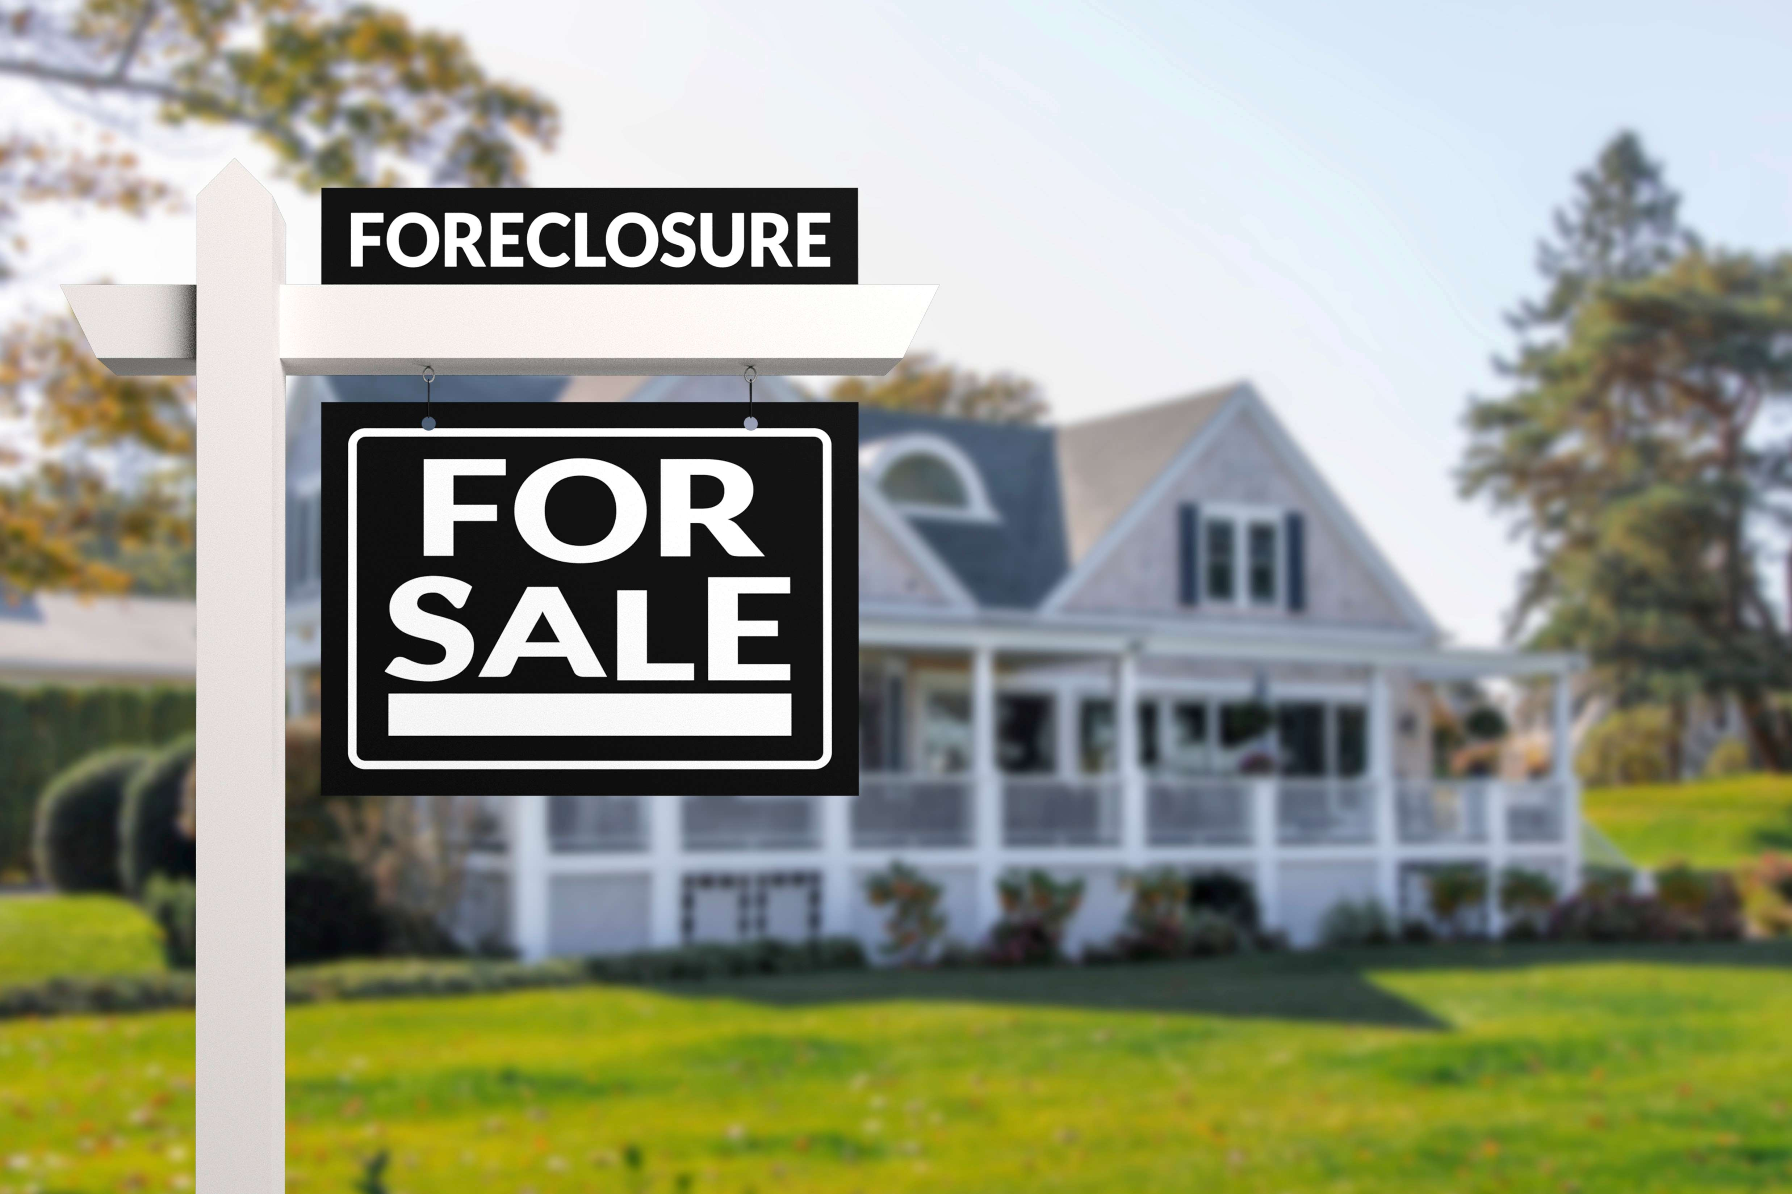
Center for REALTOR® Development ©2024
312

Slide 312

Making the Offer
List price may not reflect true value
Offer typically made to asset manager
Must have preapproval, earnest money or proof of funds
REO PROPERTY
Center for REALTOR® Development ©2024
313

Slide 313
What to Expect
Pressure for quick closing
Sold as-is, where-is
Asset managers not licensees
No seller disclosures
No concessions
No contingencies for home sale or close
May get other offers while bank is signing
Acceptance handled through addendum
REO PROPERTY
Center for REALTOR® Development ©2024
314
Notes:
Discussion of REOs and short sales should be brief – not enough time to go in-depth in these – obviously if market changes and they become more prevalent we will want to spend more time here.

Slide 314
What to Expect
Property not under contract until signed by senior management at back – or authorized individual
Stays on the market until everything is signed
Offer-response takes longer than typical sale
In some cases, electronic signatures may not be allowed
REO PROPERTY
Center for REALTOR® Development ©2024
315
Notes:
Discussion of REOs and short sales should be brief – not enough time to go in-depth in these – obviously if market changes and they become more prevalent we will want to spend more time here.

Slide 315
Protect Your Client
Don’t write on counter addendums
Check counter addendum for alterations from agreed terms
Encourage buyer to schedule a thorough home inspection
Take photos for the buyer at the time of purchase contract
Meet all deadlines for inspections
Purchase comprehensive title insurance
Close on time to avoid penalties
REO PROPERTY
Center for REALTOR® Development ©2024
316
Notes:
Discussion of REOs and short sales should be brief – not enough time to go in-depth in these – obviously if market changes and they become more prevalent we will want to spend more time here.

Slide 316

Center for REALTOR® Development ©2024
317

Slide 317
Making the Offer
Sometimes underpriced to attract buyers – do your homework
Offer made to seller but approved by lender.
Provide approval letter or proof of funds with contract
Contract should have reasonable chance of closing
Offer a fair price, or risk lender turning it down.
Provide fair amount of earnest money
Do home inspections and mortgage application in timely manner
SHORT SALE
Center for REALTOR® Development ©2024
318

Slide 318
What to Expect
Can take 30-180 days for lender to approve
Seller’s acceptance does not guarantee lender approval
Even full price offer doesn’t guarantee approval
Buyer must be flexible on closing date
Lender will pressure for quick close once approved
Sold as-is – do not expect lender to make repairs
SHORT SALE
Center for REALTOR® Development ©2024
319

Slide 319
Protect Your Client
Not depositing earnest money before approved by lender could weaken offer
Try to include a “no subsequent offers” clause in contract
Check for liens on the property
Stipulate in contract how long buyer will wait for lender approval before withdrawing
International buyers – funds must be transferred promptly and cultural issues sometimes arise
SHORT SALE
Center for REALTOR® Development ©2024
320

Slide 320

Center for REALTOR® Development ©2024
321

Slide 321

Practitioner Perspective
Educating buyers
Top 3 things that affect negotiating
Prepare buyers for multiple offers
Escalation clauses
Remember Einstein Learn the rules – and then play better than anyone else
Center for REALTOR® Development ©2024
322

Slide 322
Key Point Review — Module 5
Preparing the buyer to make an offer involves educating them on the process while also understanding their emotions
REALTORS® should analyze and interpret the data and present a clear market analysis on the property prior to making an offer
REALTORS® should assess a client’s advantages and prior to developing an offer
There are many offer scenarios: multiple offers, escalation clause, variable rate disclosures, REO and short sales, and counteroffers
Center for REALTOR® Development ©2024
323
Notes:
Course Notes:
Review the scenario presented in A Day in the Life of a Buyer’s Representative. Use this scenario as the basis for discussion of the module objectives.

Slide 323
A Day in the Life of … A Buyer’s Rep
Your opportunity to review Module 5 concepts
Center for REALTOR® Development ©2024
324

Slide 324


Module 6: From Contract to Closing

Slide 325
Module 6 Learning Objectives
Explain the immediacy of contingencies to clients and outline the mortgage application process
Guide your client through the home inspection and appraisal process
Ensure that your client knows the different types of required insurance and understands the closing process
Center for REALTOR® Development ©2024
326

Slide 326
Contract Contingencies
Typical contingencies
Home inspection
Financing / appraisal
Other contingencies – Give buyer a timeline/checklist
Delivery of earnest money
Mortgage application
Homeowner’s and flood insurance
Home inspection
Intent to proceed to lender
Mortgage commitment date
Center for REALTOR® Development ©2024
327

Slide 327

Mortgage Application
Time frame for mortgage application in your contract?
Buyers sometimes think the pre-approval step was the mortgage application
Educate them on the timeline
Center for REALTOR® Development ©2024
328

Slide 328
Mortgage Application Follow-Up
Clients should begin compiling information prior to application
Provide advance list of documents that area lenders typically request
Communicate with lender – can you assist with requests for additional documentation?
Need Additional Documentation for:
Military and veterans
Self-employed
Divorce
Financial subsidies
Past financial distress
Center for REALTOR® Development ©2024
329

Slide 329
Loan Estimate Comparison
$
$
$
Apply with multiple lenders
All must give loan estimate
Buyers should compare carefully:
Rate and terms?
Closing costs?
Origination charges, etc.?
Give chosen lender “Intent to Proceed.”
Lender must give Loan Estimate within 3 business days
Meet with Lenders
3
3 Working Business Days
Compare Loan Estimates
Center for REALTOR® Development ©2024
330

Slide 330

Loan Estimate Comparison
Is rate locked?
Loan amount correct?
Fixed or adjustable?
Discount points correct?
Loan type correct?
Prepayment penalty?
Monthly payment acceptable?
Center for REALTOR® Development ©2024
331

Slide 331

Loan Estimate Comparison
How do charges compare to other lenders?
Insurance accurate?
Property taxes accurate?
Cash to close correct?
Expiration date – lock in correct?
Center for REALTOR® Development ©2024
332

Slide 332
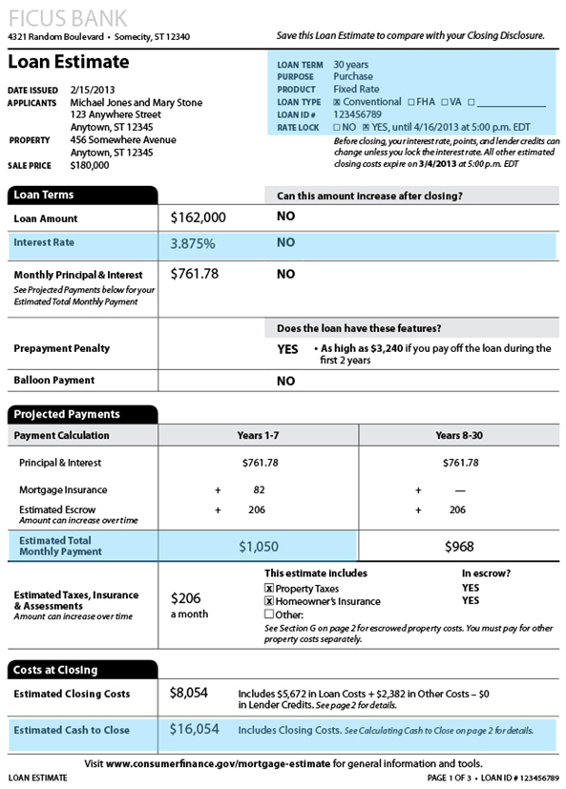
Sample Loan Estimate
Center for REALTOR® Development ©2024
333

Slide 333
No Changes to Financials
Maintain financial picture between contract and closing
Avoid:
Adding or closing new credit lines/accounts
Closing credit card accounts
Changing jobs (or quitting)
Large purchases—car, furniture, etc.
Changing bank accounts
Co-signing for a loan
Making large deposits or withdrawals
Center for REALTOR® Development ©2024
334
Notes:
Remind them that lenders re-check employment and credit right before the closing.

Slide 334

Home Inspections
Schedule ASAP — watch contract dates
Buyer should attend
Contract language prevails:
Need licensed inspector?
Dollar amount specified?
Routine maintenance not included
Definition of functional
Center for REALTOR® Development ©2024
335

Slide 335
Home Inspections
Options – Consequences
Can buyer cancel if not satisfactory?
Might client lose if they request too many repairs?
Consider situation: multiple offers, type of market, etc.
There could be a back-up – seller could terminate contract
Center for REALTOR® Development ©2024
336

Slide 336
What happens when appraisals come back low — when home appraisal derails the process

Slide 337

Home Sales Price High — Appraised Value Low
Most loans require the property to appraise for purchase price
In sellers’ market when prices are escalating it is not unusual for the appraisal to be low
Buyer has options – depending on what was negotiated at time of contract
Walk away
Ask seller to reduce the price
Ask lender to discuss with appraiser
Center for REALTOR® Development ©2024
338

Slide 338
FNMA Guidelines
Lender initiates discussion
Request for change must be based on material and substantive issues
Cannot be because it does not support sales price
Center for REALTOR® Development ©2024
339

Slide 339
Process for Disputed Appraisals
Done by buyer or buyers’ agent – not listing agent
Go over it with buyer
Must have buyers’ permission
Agents work together
Center for REALTOR® Development ©2024
340

Slide 340
Appraising the Appraisal
Are there errors?
Comps too old
Comps from another school
Inappropriate adjustments
Challenge outliers
Wrong neighborhood
Square footage error
Left off improvements
Bed or bath count incorrect
Center for REALTOR® Development ©2024
341

Slide 341
Residential Appraisal Report Give Appraiser a Reason
Submit new information
Submit new comps
Pending now closed
Those not used that should have been
Those that should not have been used
Center for REALTOR® Development ©2024
342

Slide 342

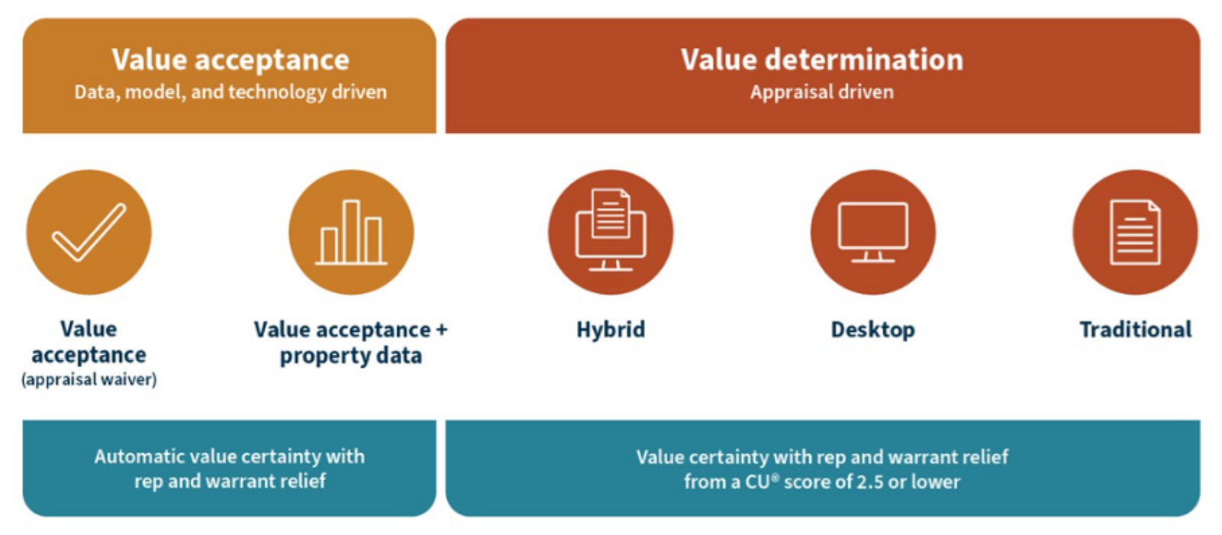
Center for REALTOR® Development ©2024
343

Slide 343
FNMA Appraisal Alternatives
A FNMA appraisal alternative is an offer to waive the appraiser-conducted appraisal
Buyer saves appraisal fee in most cases
Appraisal is done faster in most cases
FNMA uses their database which has over 61 million appraisal reports (as of 3/23)
Center for REALTOR® Development ©2024
344

Slide 344
Appraisal Alternatives
Valuation Acceptance (Appraisal Waiver): This option will be considered on principal and secondary residence purchase transactions with a Loan to Value (LTV) of 80% or less.
Valuation Acceptance and Property Data: Fannie will offer an appraisal waiver subject to “property data collection by a third party who conducts interior and exterior data collection on the subject property.”
Hybrid Appraisal: Started as Value Acceptance and Property Data and something changed. The property data would be forwarded to a licensed appraiser, who would perform the valuation analysis based on the information provided by the third-party data collector.
Center for REALTOR® Development ©2024
345

Slide 345
Desktop Appraisal. Appraiser does not physically inspect the property – uses data from various sources including FNMA data base.
Traditional Appraisal. Appraiser collects property data and completes the market analysis required for the appraisal.
Center for REALTOR® Development ©2024
346

Slide 346
VA Tidewater
Appraiser provides Tidewater Notice to lender
Lender notifies agents of Tidewater Initiative
REALTORS® can each submit 3 additional comps – 2 days
Appraiser cannot discuss contents of the appraisal
Additional information is reviewed by appraiser
VA underwriter reviews and completes appraisal
Appraisal is provided to the Veteran
117
347
Center for REALTOR® Development ©2024

Slide 347
Property Insurance
Should verify during due diligence
Purchase prior to closing
Loss claims made by previous owner figure into premiums
Buyer credit history also figures into premiums
Center for REALTOR® Development ©2024
348

Slide 348
Flood Insurance
Due Diligence:
Is home located in flood zone?
May be required by lender
National Flood Insurance Program
NAR’s NFIP Toolkit
Center for REALTOR® Development ©2024
349

Slide 349
Policy of Title Insurance
Protects policyholder from losses resulting from defects in the title
Lender’s title policy (required):
Insures validity and enforceability of mortgage document
Owner’s title policy (suggested):
Protects buyer’s ownership rights
Include an owner’s title policy in the contract
Center for REALTOR® Development ©2024
350

Slide 350

Pre-Closing Walk-Through
Most contracts entitle buyer to inspect home shortly before close
Buyer should do so personally
Condition of home same?
Seller vacated?
Repairs completed?
If major problems, buyer can ask for delayed closing or additional money in escrow to cover repairs
Buyer agents should not do the walk through for their buyers
Center for REALTOR® Development ©2024
351

Slide 351
Prepare Buyer for Closing
Preparation reduces stress and avoids problems
Take more time with first-time buyers
Advise client on who will attend, what to expect, etc.
Closing processes vary – out of state buyers may be used to a different process
Center for REALTOR® Development ©2024
352

Slide 352
Closing: Gather All Forms and Documents
Identification—photo ID
Sales contract
Proof of homeowner’s insurance
Proof of title search and title insurance
Home appraisal
Home inspection reports
All funds for down payment, closing costs, and any other fees
Many title companies do not take personal checks
Center for REALTOR® Development ©2024
353
Notes:
Course Notes:
The COVID-19 pandemic brought many changes to our industry and one of the biggest was the contactless closing. Many professionals believe this new closing format will continue.

Slide 353

Closing: Who Attends?
Varies by state and local custom
The buyer — referred to as the mortgagor
The seller
Real estate agents for buyer and seller
Closing agent — usually employee of title company
The lender — referred to as the mortgagee
Attorneys — for both buyer and seller
Unwritten rule – client there – you’re there!
Center for REALTOR® Development ©2024
354

Slide 354

Closing: What to Expect
Sign legal agreements
Pay down payment and closing costs
Receive keys
Inspect copies of closing documents
Center for REALTOR® Development ©2024
355

Slide 355

After the Closing
Due Diligence Moving Forward
Where referrals are won or lost
Help buyers compile a file of documents received at closing
Prepare a mailing dated January of following year containing anything buyers might need for taxes
Show appreciation with a personalized gift for client or their new home
Center for REALTOR® Development ©2024
356

Slide 356

A few thoughts …
Re-key the locks
Gift certificate for handyman service
Cleaning service
Dinner delivery on moving day
Landscaping gift certificate
Safety items if needed
Center for REALTOR® Development ©2024
357

Slide 357
Client Data Privacy and Security
Make it office policy
Protect security, confidentiality, and integrity of client data
Protect yourself
Center for REALTOR® Development ©2024
358
Notes:
Course Notes:
NAR Data Privacy and Security toolkit available at https://www.nar.realtor/data-privacy-security/nars-data-security-and-privacy-toolkit

Slide 358
Wire Fraud
Hacker accesses emails and redirects funds to bogus account
Money is almost always gone and never recovered
Huge increase of wire fraud incidents in real estate
Steps to prevent:
Educate clients
Be vigilant and VERIFY
Use cloud-based security systems
Center for REALTOR® Development ©2024
359
Notes:
Course Notes:
Review Exercise 5-4 Identifying Wire Fraud as a class.
Suggest learning more about data privacy by taking NAR’s e-Pro certification course: https://www.nar.realtor/education/designations-and-certifications/e-pro

Slide 359
Key Point Review —Module 6
Contract contingencies must be resolved in a timely manner to prevent the contract from becoming void
Counsel buyers to refrain from making changes to their financial picture until after the closing
The results of home appraisals and home inspections can delay the closing process
Center for REALTOR® Development ©2024
360
Notes:
Course Notes:
Review the scenario presented in A Day in the Life of a Buyer’s Representative. Use this scenario as the basis for discussion of the module objectives.

Slide 360
A Day in the Life of … A Buyer’s Rep
Your opportunity to review Module 6 concepts
Center for REALTOR® Development ©2024
361

Slide 361

Module 7: Putting It All Together

Slide 362
Module 7 Learning Objectives
Understand and apply four important strategies for success as a buyer’s representative
Apply troubleshooting scripts to respond to buyer concerns
Utilize the pro tips and tools to ensure success as a buyer’s representative
Center for REALTOR® Development ©2024
363

Slide 363
Strategy – Plan To Succeed
Know your strengths and weaknesses
Know your duties and responsibilities
Know your competition
Know your unique value proposition
Center for REALTOR® Development ©2024
364

Slide 364
Responsibility, Duty, Accountability, Liability
Advocate for buyer to find them the right home at the right price
Comply with all federal, state, and local laws
Watch for risky areas of screening, steering, advertising, and predatory lending
Abide by the REALTOR® code of ethics, and to always act in the consumer’s best interests
Center for REALTOR® Development ©2024
365

Slide 365
Skilled Negotiator
Patient but persistent
Organized and innovative
Aware of other’s emotions and situations
Honest and prepared
Aware of legal accountability
Flexible and open to suggestions
Assertive without being demanding
Looking for win-win that doesn’t compromise client
Center for REALTOR® Development ©2024
366

Slide 366
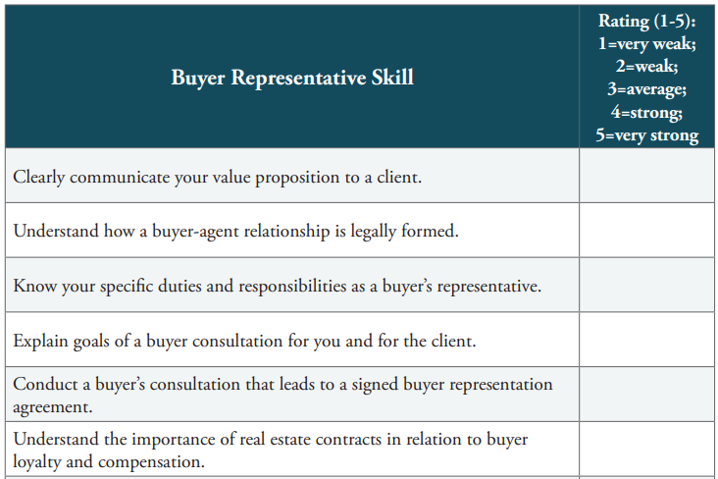
Buyer Rep Skills Self-Assessment
Center for REALTOR® Development ©2024
367

Slide 367
Troubleshooting Scripts for the Field
Real estate is complex and dynamic
Difficult situations are part of business
Be prepared and know constructive ways to respond
Center for REALTOR® Development ©2024
368

Slide 368
When the Buyer Doesn’t Want Initial Counseling Session
Scenario 1
I can find properties on the Internet. I really don’t need a whole counseling session. I just need you to get me in the door.
Scenario 2
If every agent has access to the MLS, what is the advantage of working with you?
Scenario 3
I know what I want already. I just need you to get me showings.
Center for REALTOR® Development ©2024
369
Notes:
Course Notes:
Review responses to scenarios. Students may have additional suggestions.

Slide 369
When Buyer Won’t Sign a Representation Agreement
Scenario 1
I would like you to work for me, but I don’t want to sign anything. I can trust you, right?
Scenario 2
I don’t like to make a commitment to just one agent. I like to keep my options open.
Scenario 3
The sales agents who show me properties seem nice, so why do I need a buyer’s rep?
Scenario 4
I’m a commitment-phobe! What if I don’t like working with you? Can I get out of this contract if I sign now?
Center for REALTOR® Development ©2024
370
Notes:
Course Notes:
Review responses to scenarios. Students may have additional suggestions.

Slide 370
When Buyer Asks About Offers, Commission, and Fees
Scenario 1
I want to find a really good deal! What can you do for me?
Scenario 2
The market is kind of confusing right now. How will you help me decide how much to offer?
Scenario 3
Is your commission negotiable?
Scenario 4
Do I have to pay a fee if I do not buy a home?
Scenario 5
If your commission is based on the sale price, how can I be sure you will try to get me the best deal?
Center for REALTOR® Development ©2024
371
Notes:
Course Notes:
Review responses to scenarios. Students may have additional suggestions.

Slide 371
When Dealing With FSBOs
Scenario 1
If sellers can go FSBO, why can’t I make a purchase on my own?
Scenario 2
A client of yours is interested in looking at FSBOs and asks you to check out any local listings. How do you approach sellers in various situations?
Center for REALTOR® Development ©2024
372
Notes:
Course Notes:
Review responses to scenarios. Students may have additional suggestions.

Slide 372
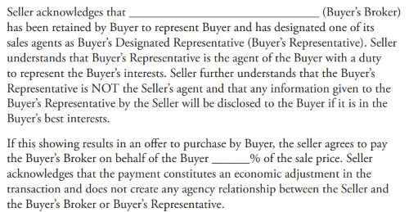
Sample Agency Disclosure and Brokerage Fee Agreement for Unlisted Property
Center for REALTOR® Development ©2024
373

Slide 373

Technology
Technology has altered the real estate landscape
In some ways more challenging, but easier in many other ways
You can now work faster and more efficiently
Most-used tools: MLS apps, lockbox devices, and social media
Center for REALTOR® Development ©2024
374

Slide 374
Technology Helps Manage Time
Customer Relationship Management (CRM)
Target the best leads
Send bulk messages
Manage social media
Implement drip campaigns
Manage client accounts
Reminders of clients’ closing anniversaries, birthdays, etc.
Manage and monitor your financials
Center for REALTOR® Development ©2024
375

Slide 375
Social Media Strengthens Your Business
75% of NAR members use social media for business.
Provides strongest leads
Most used: Facebook, LinkedIn, and Instagram
Buyers ages 30 and under grew up with social media — now account for 82% of first-time buyers
All buyers expect to connect with you online
Brand consistency across platforms
Center for REALTOR® Development ©2024
376

Slide 376
Key Point Review —Module 7
Assessing yourself and your competition is essential to success
Building a unique value proposition pays off for your business
Preparation helps you respond effectively to common client concerns
Client relationships are a valuable resource
Center for REALTOR® Development ©2024
377
Notes:
Course Notes:
Review the scenario presented in A Day in the Life of a Buyer’s Representative. Use this scenario as the basis for discussion of the module objectives.
Prepare students to take course exam.

Slide 377
Next Steps: Bring It All Together
We’ve discussed the role and responsibilities of being a buyer rep
We learned about the counseling session, the search-selection-showing process
We took a deep dive into assisting our buyers in the formulation and negotiation of their contract
Reviewed how to get the transaction to the closing table
Center for REALTOR® Development ©2024
378
Notes:
Course Notes:
All requirements must be completed within three years of passing the Accredited Buyer’s Representative (ABR®) designation course.
These requirements must be met to attain and use the ABR® designation:
Successful completion of the two-day Accredited Buyer’s Representative (ABR®) designation course, including an 80% passing grade on the exam. After you complete this course you will have three (3) years in which to complete the other ABR® designation requirements.
Successful completion of one of the ABR® elective courses, including an 80% passing grade on the exam. This course may be taken prior to completing the Accredited Buyer’s Representative (ABR®) designation course.
Five (5) completed transactions in which the ABR® candidate acted as a buyer’s representative. Any transactions closed prior to taking the ABR® designation course or closed within three years after completing the course are eligible for credit.
Membership in good standing in the Real Estate Buyer’s Agent Council (REBAC) and the National Association of REALTORS®.

Slide 378
A Day in the Life of … A Buyer’s Rep
Your opportunity to review Module 7 concepts
Center for REALTOR® Development ©2024
379

Slide 379

Resources and Exercises

Slide 380
Resources & Exercises
Glossary
Websites
Sample Buyer Rep Agreement
Exercises
Center for REALTOR® Development ©2024
381

Slide 381
Thank You For Your Participation!
Notes:
If you are not doing the exercises – you can stop here.
If you did the exercises as you went through the material – you can stop here.
If you want to do the exercises – there is a ‘end’ slide at the end of the exercise slides.

Slide 382

Sample Buyer Rep Agreement
This is merely an example of what a Buyer Representation Agreement might look like
It is written in ‘plain language’ without a lot of legal jargon which should help you be able to explain your agreement to your buyers
You are advised that no agreement you download from the Internet, or any other source, should be used without your brokerage’s permission
Center for REALTOR® Development ©2024
383

Slide 383
Analyze your strengths and weaknesses by doing a SWOT analysis
 | Helpful (to achieving the objective) | Harmful (to achieving the objective)
Internal Origin (attributes of the organization) | Strengths (S) | Weaknesses (W)
External Origin (attributes of the environment) | Opportunities (O) | Threats (T)
Center for REALTOR® Development ©2024
384
Notes:
An individual SWOT analysis cannot be done in a group environment – this is the set it up for them, show them how important it is and, hopefully, instill why they really need to do this.

Slide 384
Strengths (S) | Weaknesses (W)
Typical internal factors
You have some degree of control
Does brokerage have name recognition?
Does it have resources?
How experienced and knowledgeable are you?
Do you have strong list of contacts and connections?
What is your current advertising strategy?
Center for REALTOR® Development ©2024
385

Slide 385
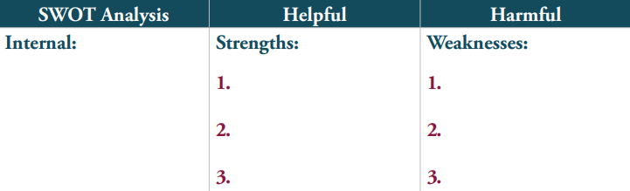
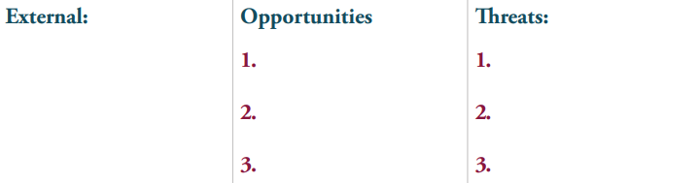
Exercise 1-1: My SWOT Analysis
Assign each factor as either an opportunity or threat – a strength or a weakness.
Center for REALTOR® Development ©2024
386

Slide 386
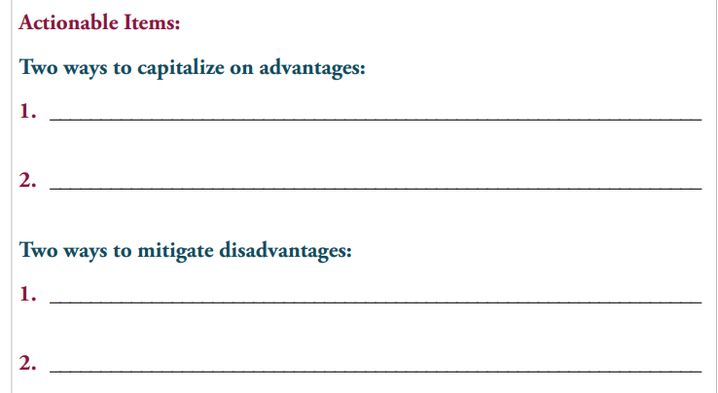
What will you do – what actionable items
Center for REALTOR® Development ©2024
387

Slide 387
Exercises

Slide 388
Exercise 4-1: Allyson and Janie
Not agreeing on much of anything
One wants suburbs – one wants to walk to dining and shopping
One wants small yard – no maintenance
One wants a garden
One wants 3 BR – other says 2
How would you respond?
What questions would you ask?
Center for REALTOR® Development ©2024
389
Notes:
We have created slides for many of the exercises – you will never have time for all of them. If you prefer slides for the others – knock your socks off! You can make them or just do the exercises from the manual ☺

Slide 389
Exercise 4-2: Darrell and Melissa
Listed at $259,000
You were told sellers:
Had accepted an offer of $235,000
Were very motivated
Had a roof that would need replacing
Now willing to possibly take less
On-line AVM’s show value of $245,000 – that’s what they want to offer
What can/should you tell them?
Center for REALTOR® Development ©2024
390
Notes:
Again – watch your time – may need to recap these instead of group breakouts and discussions

Slide 390
Darrell and Melissa
Depending on your state agency law
Designated Agency – You don’t work for the sellers
Brokerage creates agency – implied knowledge
Center for REALTOR® Development ©2024
391

Slide 391
Akim and Jarek
You did a seller counseling on this property
You know of the seller’s motivation, bottom line and other personal information
Akim and Jarek saw the property at an open house with another agent
They ‘think’ they told the open-house agent they were working with you
What are the issues on this one?
Center for REALTOR® Development ©2024
392

Slide 392
Akim and Jarek
Open houses typically do not make the agent procuring cause
You cannot disclose anything you learned about the seller at the time of the seller counseling
You can write the contract and negotiate for the buyer
Have a buyer rep agreement and maintain good records
Center for REALTOR® Development ©2024
393

Slide 393
Rohan and Lindsey
They visit a FSBO and love it
Concerned about some deferred maintenance
Will need ground floor addition
They make arrangements for you to call the FSBO
Center for REALTOR® Development ©2024
394

Slide 394
Rohan and Lindsey
Issues could be
Home inspections
Does zoning allow the room addition
Seeking broker compensation from the seller
How would you approach the seller?
Need to research what it was listed for
Center for REALTOR® Development ©2024
395

Slide 395
Parul
Parul and her parents are looking at lofts
She starts taking pictures, sending them to friends and tweeting her excitement
Sales agent sees her excitement and adds to it
Parul’s father asks questions about heating and cooling costs, taxes, etc.
Her mother asks if it’s a safe neighborhood and would you live here as a single woman?
Center for REALTOR® Development ©2024
396

Slide 396
Parul
How would you respond to her mother?
What about the photos and tweeting?
Parul is weakening her negotiating power with her actions
What would you advise her?
Center for REALTOR® Development ©2024
397

Slide 397
Exercise 5-1: Darrell and Melissa
Want to make offers on two homes
How would you advise them?
Center for REALTOR® Development ©2024
398

Slide 398
Exercise 5-1: Rohan and Lindsey
Want to use ‘love letter’
Wants to pay $5,000 over highest offer
There are other offers
How would you advise them?
Center for REALTOR® Development ©2024
399

Slide 399
Exercise 5-1: Applying What You Know
Darrell and Melissa
Akim and Jarek
Parul
Center for REALTOR® Development ©2024
400

Slide 400
Contingency Timeline
What are the typical contingencies in your marketplace?
Who is responsible for making sure they are completed?
How much time is allowed for each?
Center for REALTOR® Development ©2024
401

Slide 401
Thank You For Your Participation!

